Slide 1
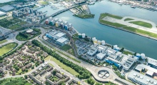
Reconsidering Nancy Fraser: Back to the Future 1997-2024
PGR Conference – Advancing Research for a Healthier Future
In her accomplished work Justice Interruptus (1997), feminist theorist Nancy Fraser identified a critically significant change in the grammar of what she termed ‘political claims making’. Representative of a paradigmatic shift, which, fast forward to the contemporary, now epitomises the arguably superlative triumph of the cultural.
Speaker: Jay Dunstan BA (Hons) MA AFHEA

Slide 2
Nancy Fraser
Nancy Fraser, born on May 20, 1947, in Baltimore, Maryland, is a distinguished American philosopher and critical feminist theorist.
Throughout her career, Fraser has been a constant presence within feminist politics and philosophy, attempting to take the best from different approaches without blunting their critical edge.
She is renowned for her work on the concept of justice, particularly her theories on the politics of recognition and redistribution. Fraser critiques contemporary liberal feminism for its focus on recognition politics alone at the expense of addressing broader social justice issues.
Her influential works include Justice Interruptus: Critical Reflections on the "Postsocialist" Condition and Fortunes of Feminism: From State-Managed Capitalism to Neoliberal Crisis. Fraser's contributions have significantly shaped debates on social justice, democracy, and feminism, making her a pivotal figure in contemporary philosophy.
Image Source: Verso Books, Nancy Fraser in her office. Available at: https://www.versobooks.com/en-gb/blogs/news/3320-redefining-feminist-scholarship-nancy-fraser-s-work-celebrated-in-a-new-volume

Slide 3
Justice Interruptus 1997
Integration of Recognition and Redistribution: Fraser argues against the dichotomy between the politics of recognition and the politics of redistribution, advocating for an integrative approach that combines sufficient provision aspects of both.
Intersection of Cultural and Socioeconomic Issues: Fraser emphasises the need to address cultural recognition and socioeconomic redistribution simultaneously, ensuring that remedies for one do not exacerbate injustices in the other.
Vision for a Just Future: Fraser's work is characterised by a commitment to envisioning and constructing a just future that integrates social equality with cultural diversity, moving beyond traditional binaries of equality and difference.
Image Source: Fraser, N. (1997) Justice Interrupts: Critical Reflections on the “Postsocialist” Condition. New York: Routledge. Artwork by Jay Dunstan.

Slide 4
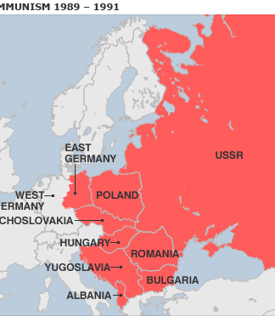
The Events of 1989
Collapse of the Eastern Bloc: The fall of communism in 1989 saw the collapse of communist regimes across Eastern Europe, starting with Poland and spreading to Hungary, East Germany, Czechoslovakia, Bulgaria, and Romania.
Fall of the Berlin Wall: One of the most iconic events was the fall of the Berlin Wall on November 9, 1989, symbolising the end of the division between East and West Germany and paving the way for German reunification.
Role of Civil Resistance: Widespread civil resistance and mass protests played a crucial role in the fall of these regimes, with citizens demanding political reform and greater freedoms.
End of the Cold War: The events of 1989 marked the beginning of the end of the Cold War, leading to the dissolution of the Soviet Union in 1991 and the emergence of new democratic governments in former communist states.
Image Source: Wikipedia commons. Communism Downfall, 1989.

Slide 5
Binaries
The events of this monumental period move the concept of justice away from redistribution to the idea and practice of recognition.
This has implications for societies here in the West.
Justice is therefore fractured and polarised.
The 'performance' of justice takes on its own logics.

Slide 6
Binaries II
Cultural
vs
Social

Slide 7
Why Injustice Endures...
Critique of Binary Choice: Fraser (1997: 3) critiques the binary choice between the cultural and the social, calling it a ‘false antithesis’ that neglects justice.
Interconnected Injustices: Fraser argues that the cultural and the social ‘both work together to produce injustices’ (Fraser, 1997: 3).
Diagnostic Scope: Critical theorists like Fraser provide a framework to understand why the interruption of justice persists despite societal progress.

Slide 8
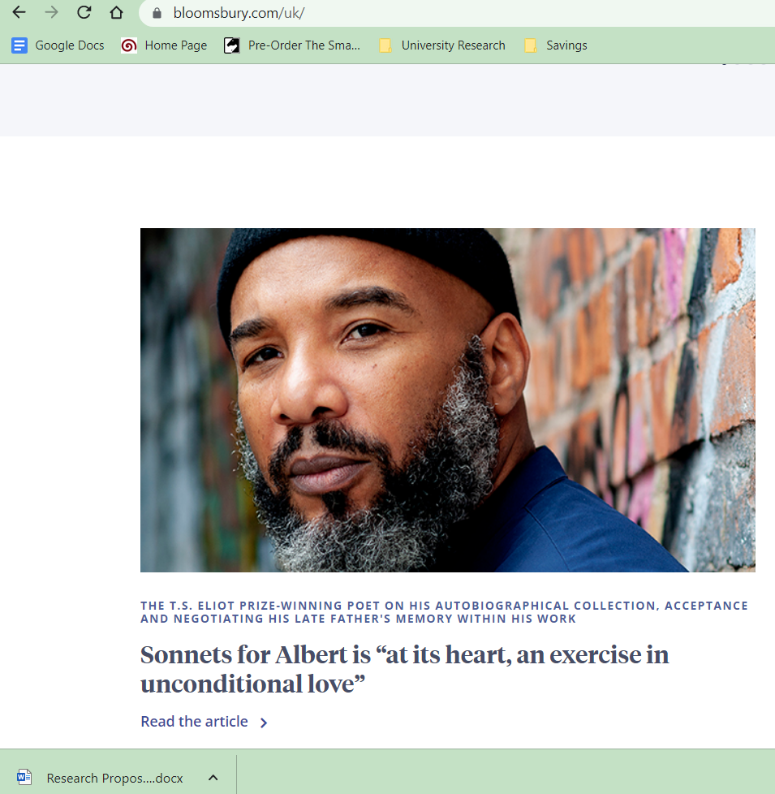
Cultural Recognition – The Performance of Equality

Slide 9
Communicating Recognition
Image Source: Jay Dunstan, various commercial and billboards.

Slide 10
Skin as Communicator of 'Justice'
Image Source: Jay Dunstan, various commercial and billboards.

Slide 11
Conclusion
Increased use of skin as politics to communicate justice and inclusion.
Lives will be reduced down to their ability to communicate inclusion.
Justice will continue to be 'interrupted' in this current societal schema.
Recognition Politics
Actual Justice

Slide 12
Thank you for your time...questions?
Contact:
Mr Jay Dunstan BA (Hons) MA AFHEA
School of Arts & Creative Industries (ACI)
u2538758@uel.ac.uk
Supervisory Team:
Professor Jeremy Gilbert
Dr Andrew Robert Branch
Dr Renata Brandao

