Slide 1
Good thinking or gut feeling? Decision-making style and rationality in traders, bankers and financial non-experts
Volker Thoma
School of Psychology

Slide 2
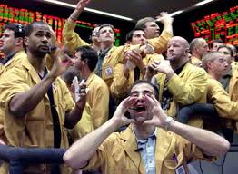

Research Question
How rational are financial
decision-makers?
  Compared to non-experts
Different style of DM?
Different risk-taking?

Slide 3
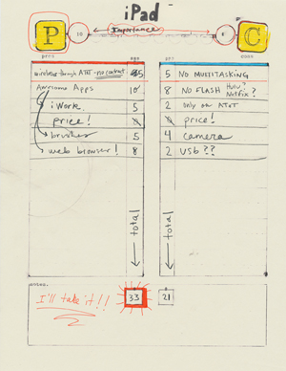
Human judgment and decision-making – Rationality
Enlightenment
  Decisions should be
  informed and logical
Rational Choice theory
  Homo oeconomicus –
  chooses the option with
  highest total utility
  (von Neumann & Morgenstern,1947)

Slide 4
The Problem with Linda
(Kahneman & Tversky, 1972)
Linda is 31 years old, single, outspoken, and very bright. She majored in philosophy. As a student she was deeply concerned with issues of discrimination and social justice, and also participated in anti-nuclear demonstrations.
Which of the following statements about Linda is more probable?
  A) She is a bank cashier.
  B) She is a bank cashier who is active in the feminist movement.
A
B

Slide 5
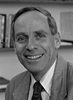

Heuristics in decision making
Heuristic: a short cut; a strategy that risks error to gain efficiency
  Vs. Algorithm: a guaranteed route to an
  outcome, may be more tedious and effortful
Tversky & Kahneman:
  measured human decision making against
  various normative standards taken from
  probability theory, statistics, and logic.
people use heuristics to make choices
These heuristics lead to biases,
i.e. systematic incorrect estimates
5
Notes:
5

Slide 6
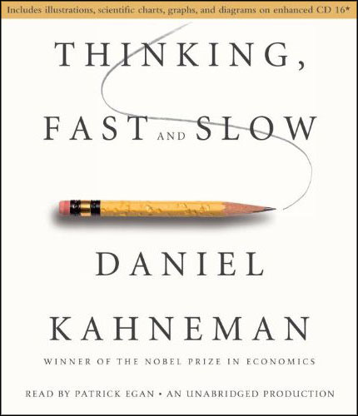
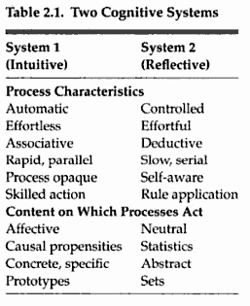
Two systems (processes) for thinking and DM
Dual process models
  Epstein, 1994; Evans, 1984, 2000; Evans & Over, 1996; Goel, 1995; Kahneman, 2002; Kahneman & Frederick, 2005; Sloman, 1996; Stanovich & West, 2000
Also found for moral reasoning

Slide 7
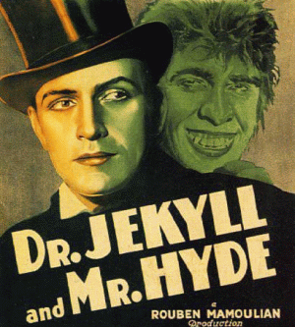
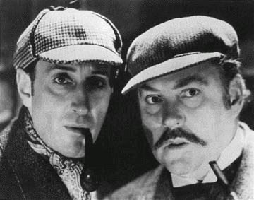


Some odd couples

Slide 8
Research Question
Are financial experts different from non-experts in
  susceptibility to heuristics?
    … and therefore “bad” decision-making
    Hilton (2000); Taleb (2004)
  Usage of DM styles?
    ‘reflective’ (rational) vs “intuitive’ (experiential)
  Risk taking?
    Financial risk-taking

Slide 9
Participants
Online questionnaire
Group 1 (n=57)
  respondents who do not work in banking or the financial industry
Group 2 (n=39)
  work in a range of financial roles in banks and related organisations
  but not in trading or trading support roles (“back” and “mid- office”)
Group 3 (n=58) are financial traders
  From 4 different banks/ trading firms

Slide 10
Methods
The Cognitive Reflection test (Frederick, 2005)
  “A bat and a ball cost £1.10 in total. The bat costs £1 more than the ball. How many pence does the ball cost?”
  measures the tendency to inhibit automatic but frequently false responses in reasoning tasks
  3 questions
REI: Rational-Experiential Inventory (Epstein & Paccini, 1999)
  Statements such as:
  I trust my initial feelings about people
  I prefer complex to simple problems
  10/24 questions
Risk questionnaire
  (Dospert et al., 2006)

Slide 11
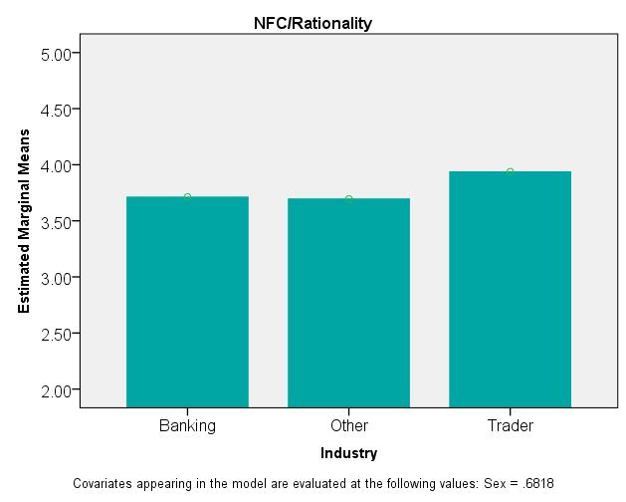
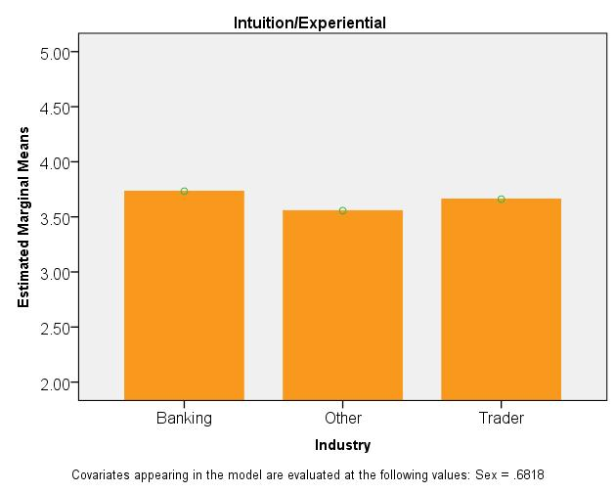
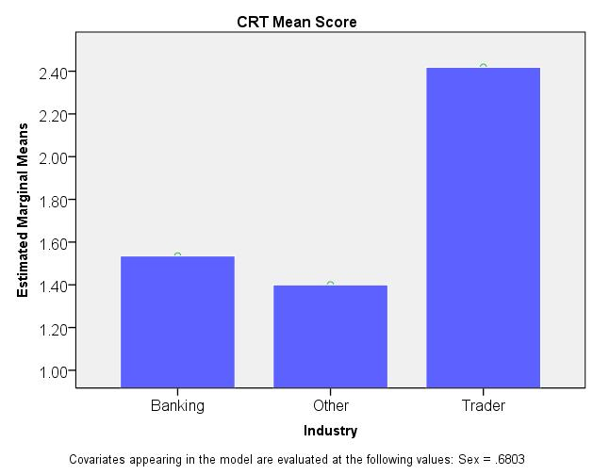
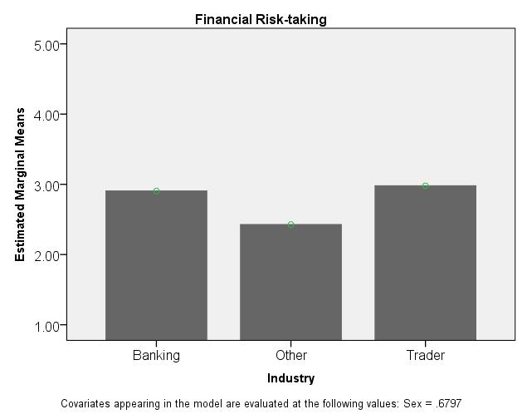
Results

Slide 12
Results – Correlations Traders

Slide 13
Summary
Traders scored significantly higher on the cognitive reflection task (CRT; Frederick, 2005)
  than both other groups
Scores for Traders were also higher on a self-rated scale for reflective thinking (REI-R; Pacini & Epstein, 1999)
There were no group differences for intuitive thinking,
  although self-rated experientiality (REI-E) correlated with age overall
Financial risk-taking was higher for Traders vs other and Bankers vs Other
Notes:
a conclusion that is supported by Toplak, West, and Stanovich (2011) who previously showed that performance on the CRT predicted heuristic thinking even when measures of cognitive ability and executive functioning were controlled for.

Slide 14
Conclusions
Traders have a higher self-rated tendency for reflective thinking and a greater propensity to inhibit the use of mental shortcuts (heuristics)
Traders in the current study showed no elevated preference to use ‘intuition’ in their decision-making compared to other groups.
  These group effects cannot be explained by differences in sex, age, or qualification
    see also Toplak, West, and Stanovich (2011)
Notes:
a conclusion that is supported by Toplak, West, and Stanovich (2011) who previously showed that performance on the CRT predicted heuristic thinking even when measures of cognitive ability and executive functioning were controlled for.

Slide 15
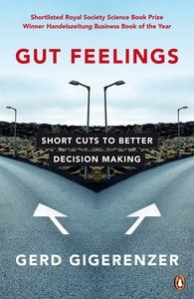
Rationality Debate

