Slide 1
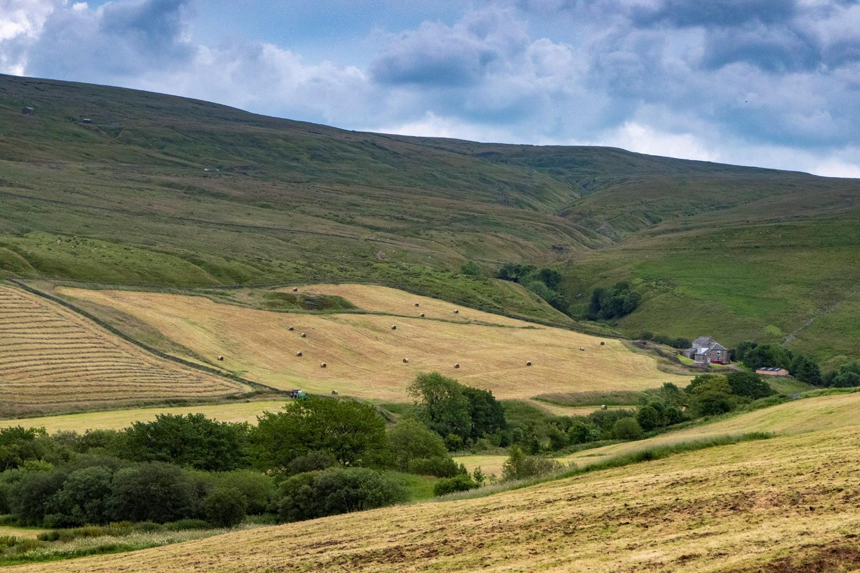
Over the top –
How far should we go..?
Richard Lindsay

Slide 2
This is typical of the upland scene in the UK today – farming in the valley bottoms, rough grazing on hill slopes, blanket bog capping the summit plateaux…

Slide 3
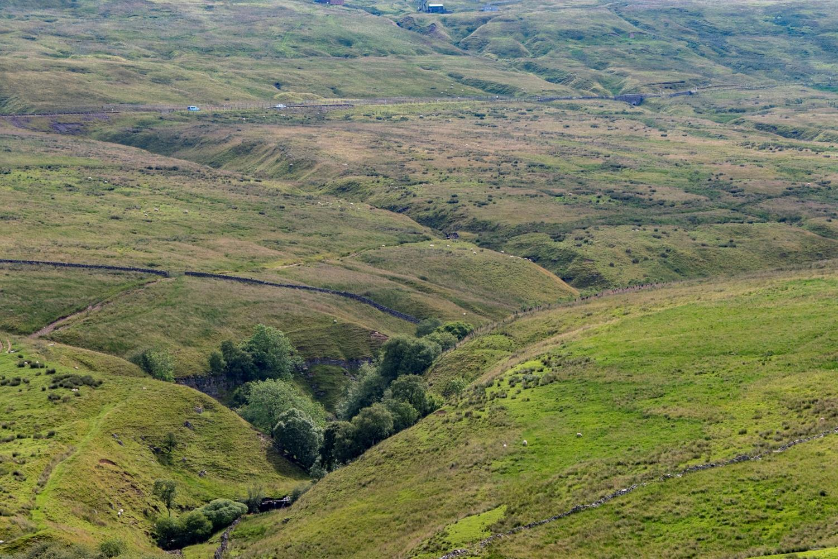
…while fragments of natural woodland cower in a few inaccessible cloughs…

Slide 4
https://iale.uk/sites/default/files/abstract_attachments/proportion-broad-habitats-british-uplands.pdf
The CEH Land Cover Map indicates that ‘bog’ (essentially areas of deep peat) takes up just over a quarter of the British uplands, while acid grassland, dwarf shrub heath, coniferous woodland and improved grassland occupy just over half of the uplands – but a significant proportion of these habitat types probably are, or once were, peatland.

Slide 5
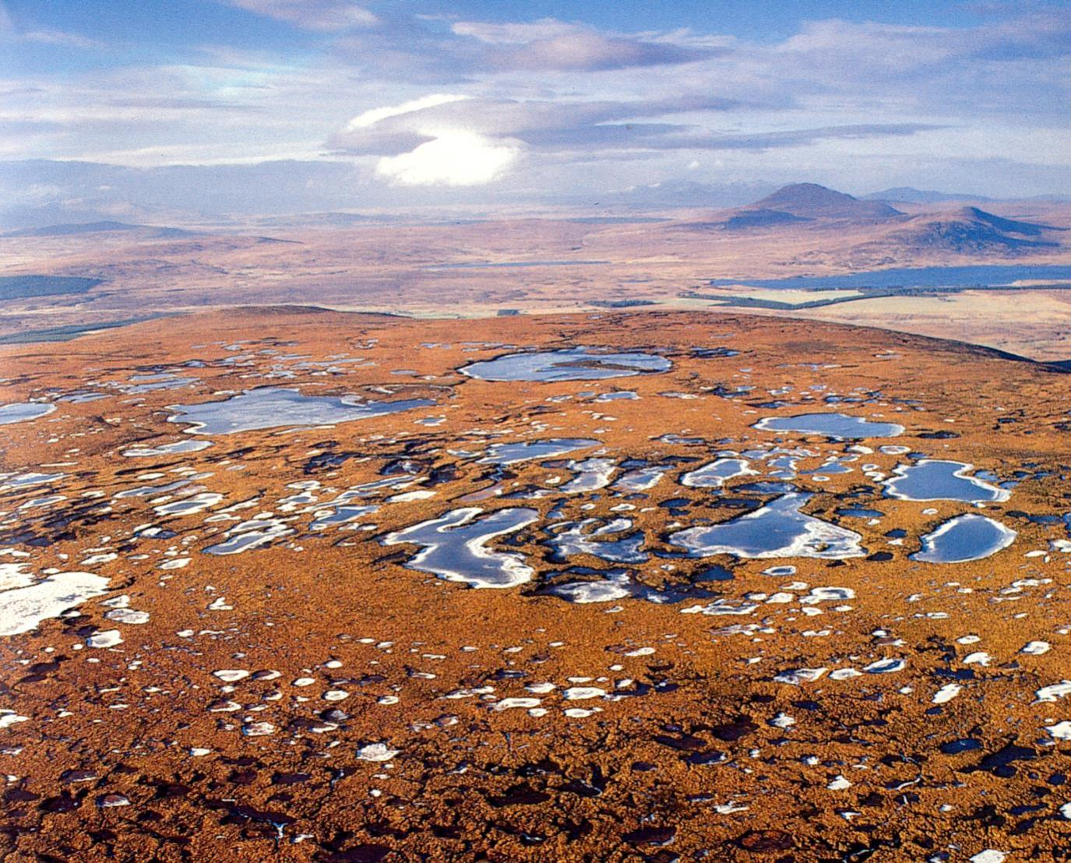
It is often stated that the blanket mires of Britain and Ireland are naturally
treeless, but it is worth noting that Lindsay et al. (1988, p.58), while
providing the first global overview of blanket mire, suggested that a
patchwork of woodland probably existed within the blanket mires of the
Flow Country on steeper slopes and along stream-sides.

Slide 6
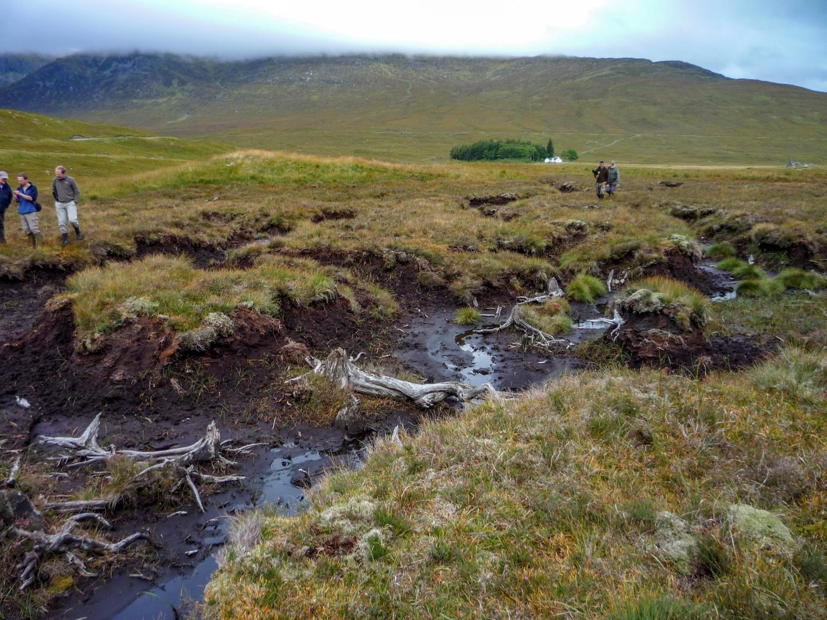
The remains of trees can be found beneath some blanket bogs, but these are generally small-diameter trees and restricted to lower-lying ground and or locations where there is, or was, distinct water seepage, or marginal areas of blanket bog habitat – as here on the edge of Rannoch Moor.

Slide 7
John Tallis & Roy Switsur surveyed 400-km2 area of the south Pennine uplands
(Switsur, V. R. and Tallis, I. H. (1983). Forest and moorland in the south Pennine uplands in the mid-Flandrian period. I, Macrofossil evidence of the former forest cover. J Ecol 71. Vol 71, pp. 585-600.
Forest and Moorland in the South Pennine Uplands in the Mid-Flandrian Period.: II. The Hillslope Forests. J. H. Tallis and V. R. Switsur. Journal of Ecology,Vol. 78, No. 4 (Dec., 1990), pp. 857-883).
Tree remains were detected at fifty-three localities; pine and birch were the commonest species, but willow and oak were also frequent.
Tree remains were recorded at various levels within the soil profile:
in the mineral soil below the peat;
at the peat-soil interface;
embedded 10-30 cm above the peat base;
embedded half-way up the peat profile.
Most tree remains occurred in the shallower marginal peats, and below 520 m altitude.
Sparse remains were recorded at altitudes up to 610 m (willow), and at the base of peat deposits up to 4. 1 m deep.
Radiocarbon datings of fifteen representative samples of tree remains showed three main groups of dates within the period 7675-3995 years B.P. (earlier than 7000 years B.P., 5410-4495 years B.P. and 4340-3995 years B.P.

Slide 8
Pollen abundance
Scrub
Upland forest
Lowland forest
9000
8000
7000
6000
5000
Years BP
They linked these three time periods with three types of woodland that
also occupied three distinct altitudinal zones

Slide 9
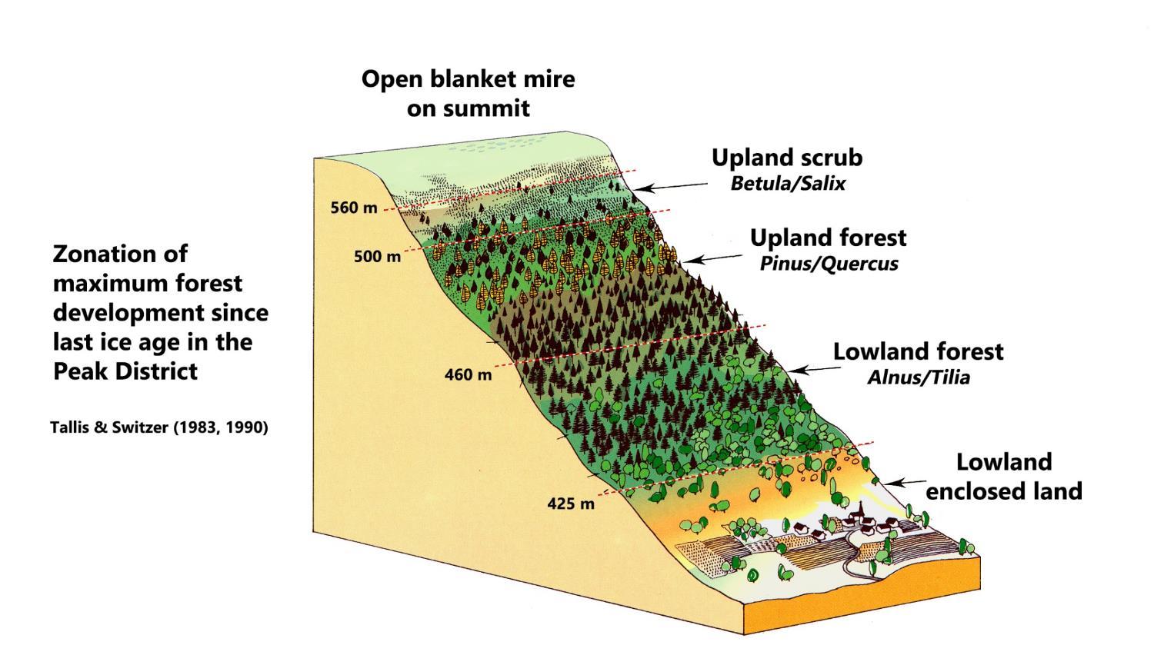

Slide 10
Mapping of these zones onto a Peak District blanket bog landscape such as Kinder Scout using a GIS reveals that the hillslopes and stream cloughs would have been dominated by lowland or upland forest, while scrub would have formed a narrow fringe between the wooded slopes and the expanse of open blanket bog dominating the entire Kinder Scout plateau.

Slide 11
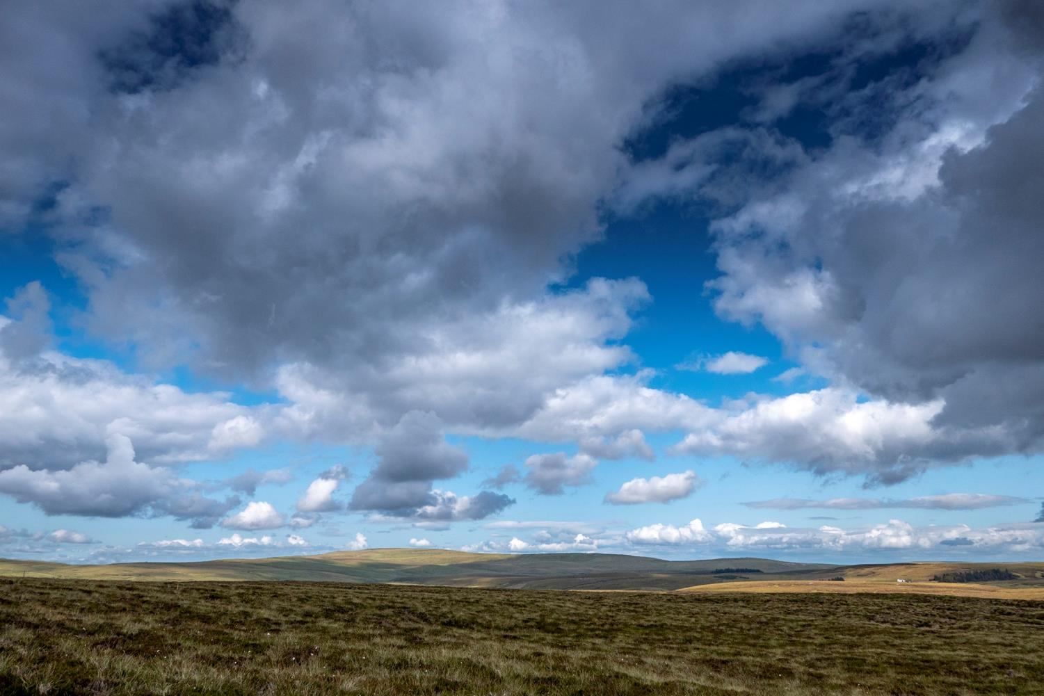
The descent of climatic conditions with increasing latitude occurs at a rate of 100 m for every 100 km northwards. Consequently, the forest and open landscape zonation observed by Tallis and Switsur in the Peak District would mean that here at Moor house in the northern Pennines, the maximum upper limit for even the scrub zone would have been around 400 m, meaning that this landscape has probably always been largely free of woodland cover. The trees we see here are small conifer plantations.

Slide 12
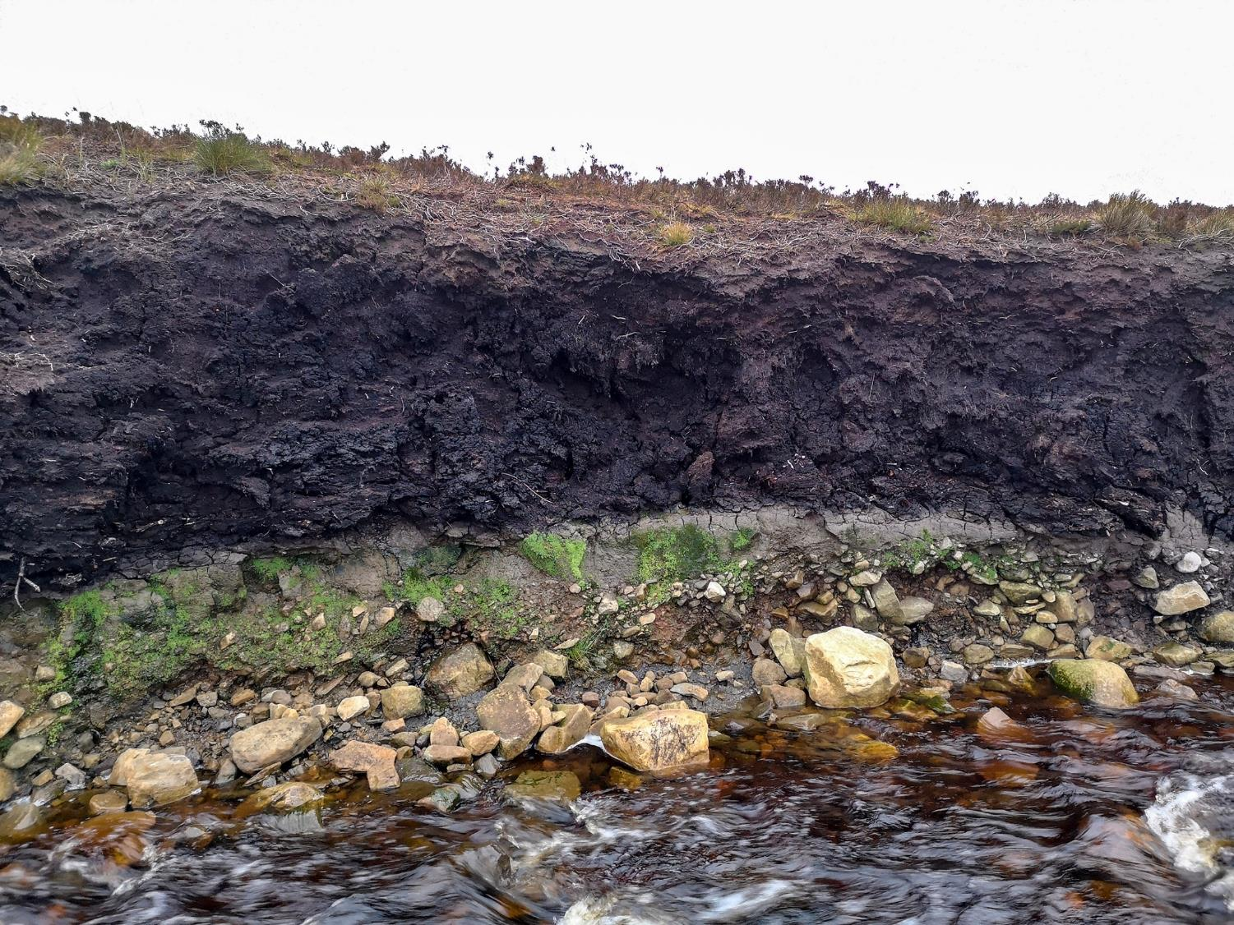
Certainly there is little sign of tree or even scrub remains in the peat where the river is eroding the river bank – a location that would tend to favour tree growth.

Slide 13
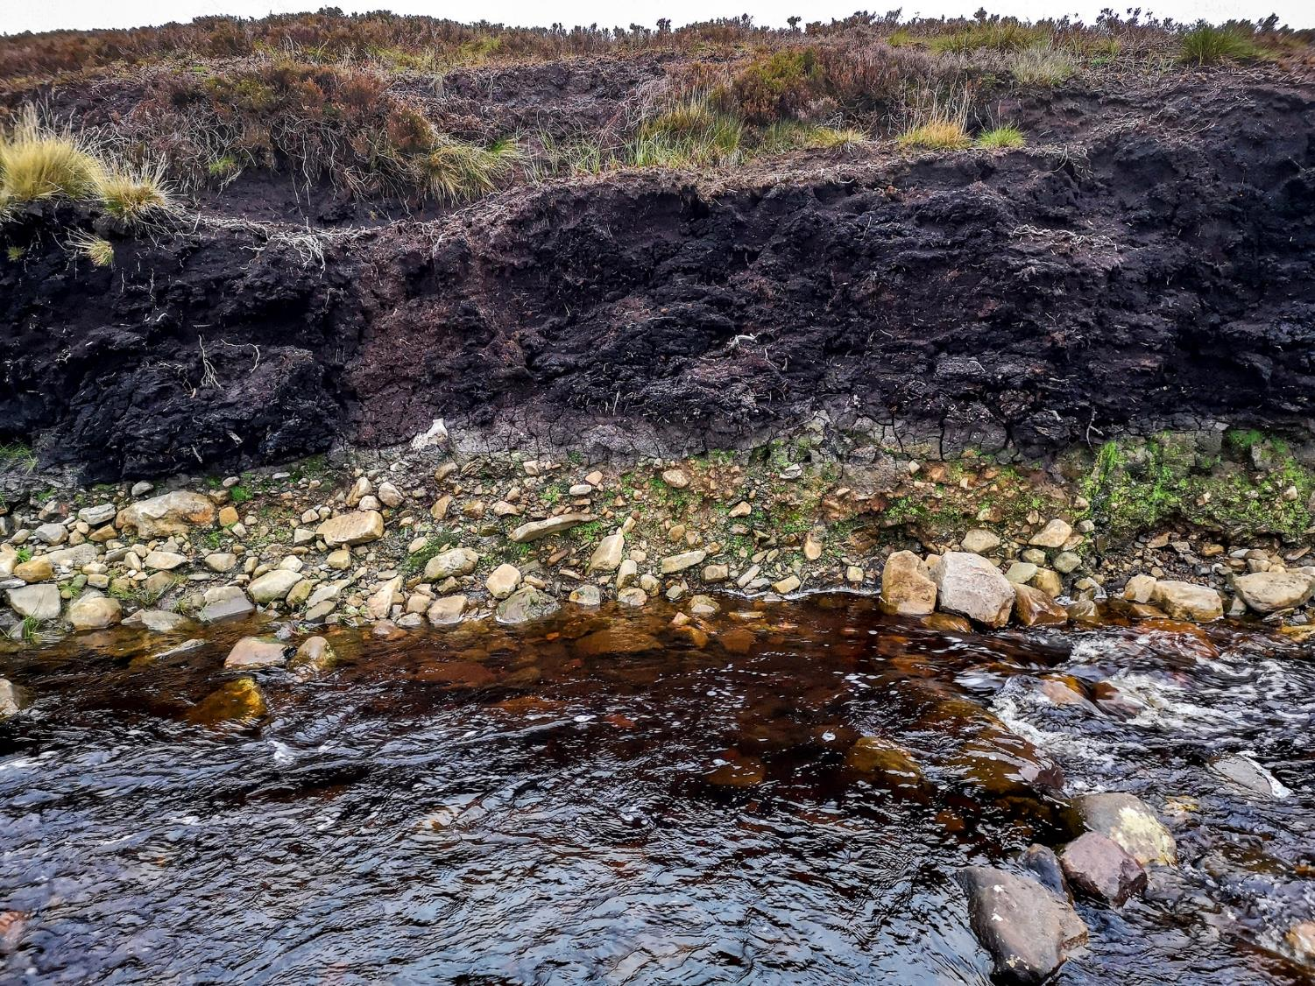
…even in areas with shallower peat….

Slide 14
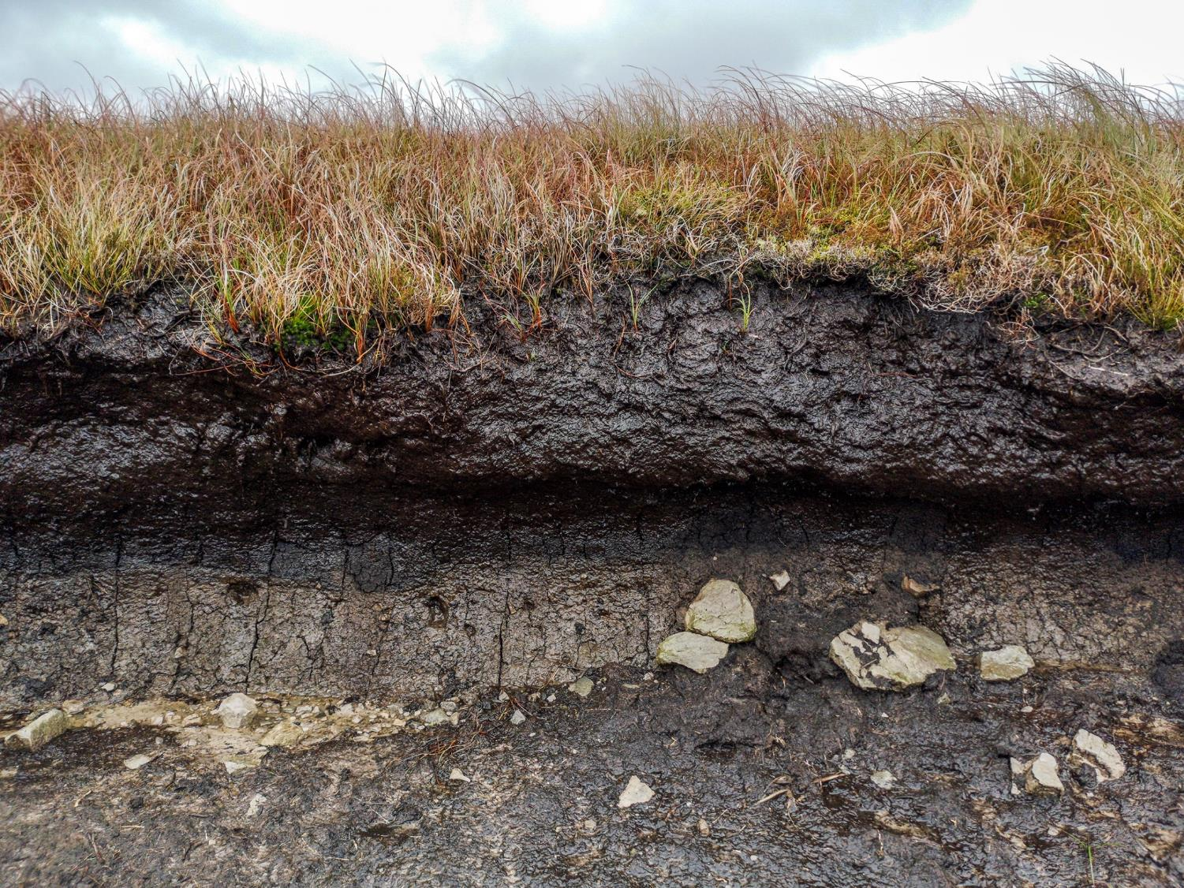
Even where the peat is very shallow, as here in a road cutting on the road between Alston and Penrith, there is no evidence of former woodland cover.

Slide 15
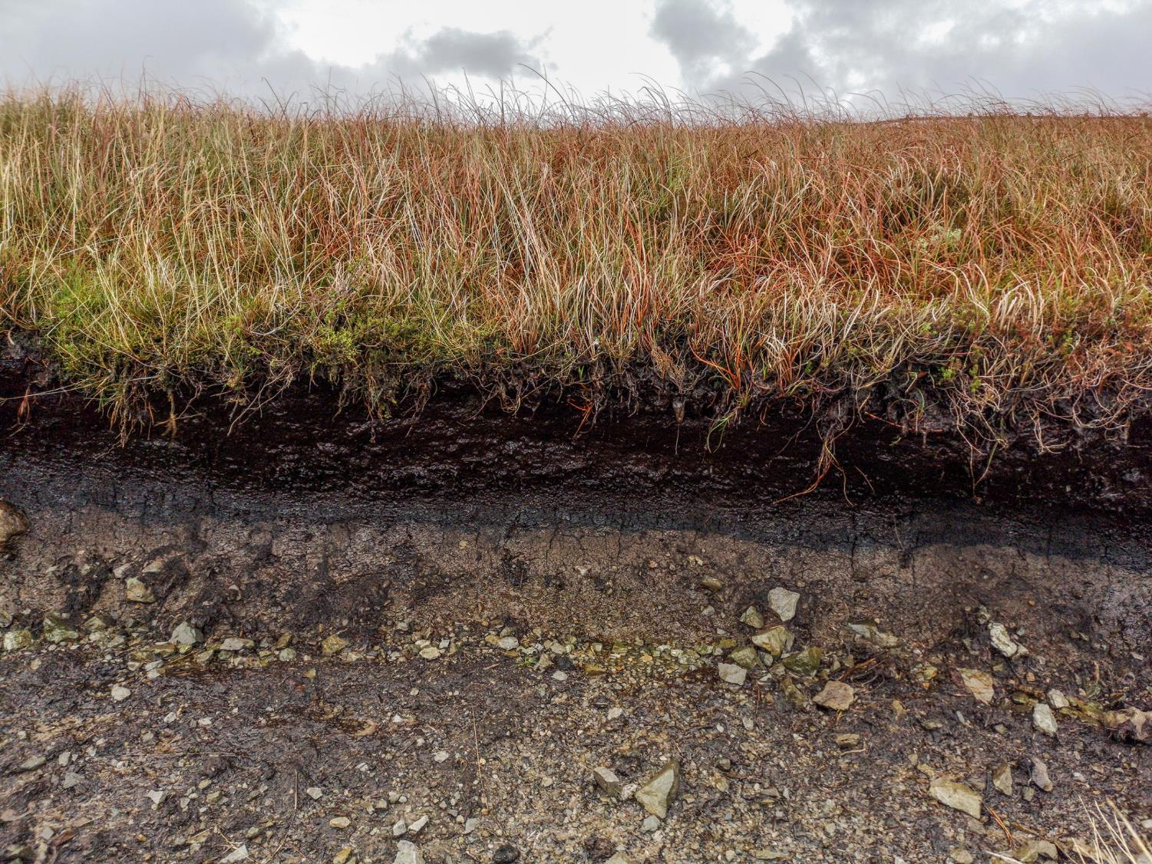
…even with the shallowest of peats…

Slide 16
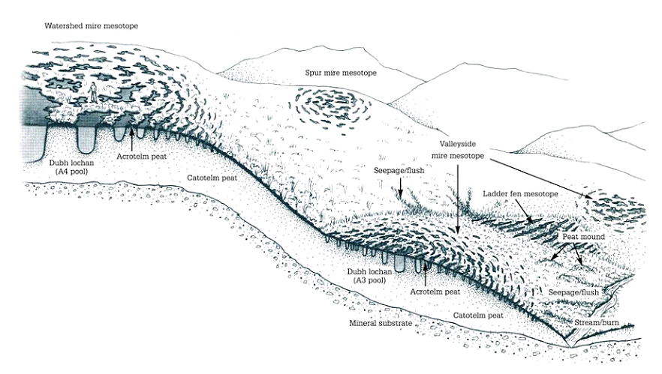
Blanket bog is not a uniform habitat.
It consists of a mosaic of steep and level ground, deep and shallow peat, and is riven with large and small fen systems – all of which offer opportunity for woodland cover in smaller or larger amounts, but the slopes with shallow peat are crucial for supporting the deeper peat upslope.

Slide 17
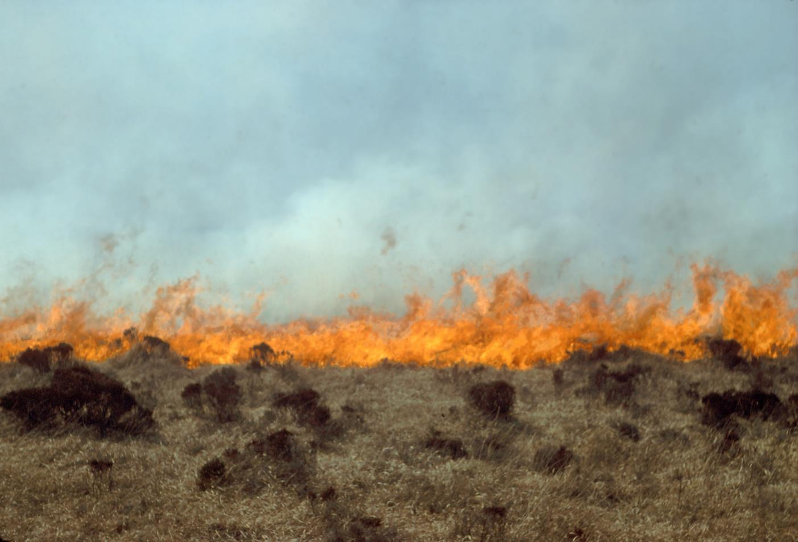
Tallis and Switsur found evidence to suggest that the upper margin of the scrub zone may have been forced back down the hill somewhat by Mesolithic use of fire as a hunting method.

Slide 18
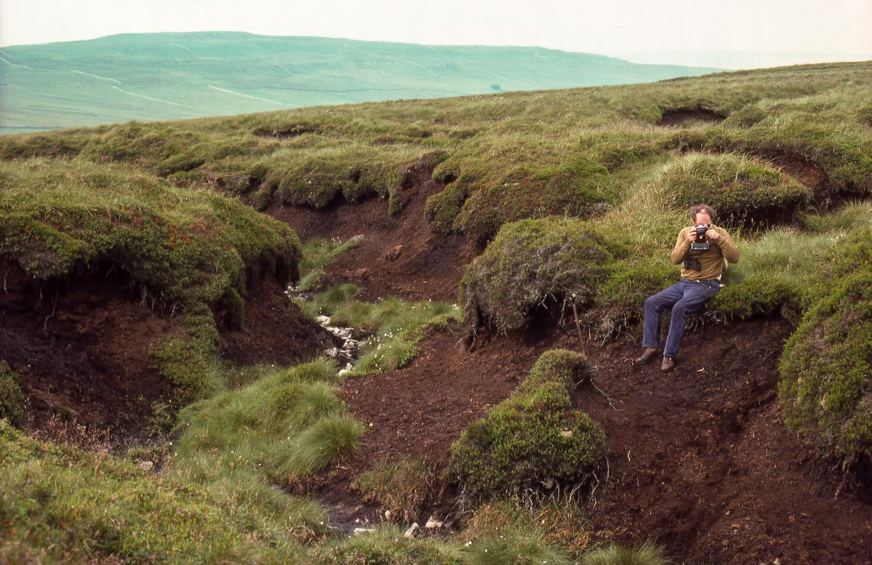
Tallis has also suggested that at least some of the intense erosion so typical of many blanket bog hill-slopes coincided with removal of hill-slope forests during Neolithic times – thus exacerbating head-ward erosion of streamcourses.

Slide 19
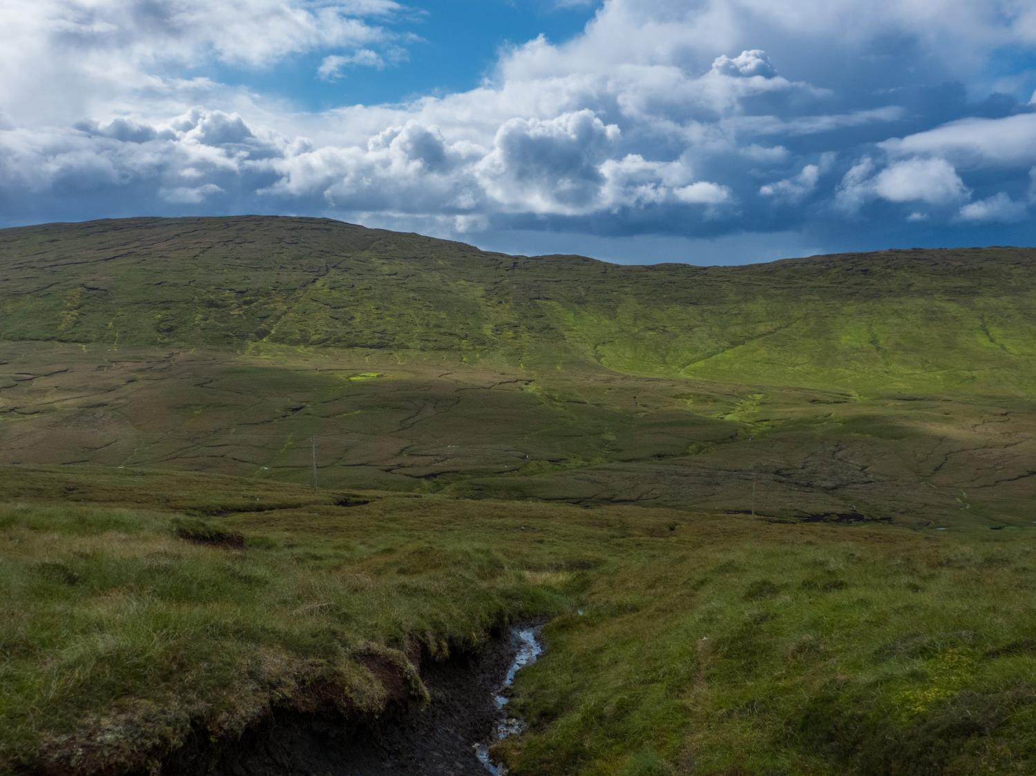
So the position we find today consists of rounded hill summits capped with peat, then an abrupt peat edge, often with low-productivity farmland below this on the slopes, and either more intensive farmland in the valley bottoms, or (as in this case) further expanses of deep peat. The blocky edges of the blanket bog capping the hill summits is plain to see.

Slide 20
But in the absence of any scrub, upland forest or lowland forest zones, John Tallis found evidence in the Peak District of ‘glacial calving’ where blocks of peat at the abrupt peatland edge had broken away from the peat mass upslope or had slid downslope to form depositional features:
Tallis, J.H. (1985) Mass Movement and Erosion of a Southern Pennine Blanket Peat. Journal of Ecology, Vol. 73, No. 1 (Mar., 1985), pp. 283-315.
Tallis, J.H. (1987) Fire and Flood at Holme Moss: Erosion Processes in an Upland Blanket Mire. Journal of Ecology, Vol. 75, No. 4 (Dec., 1987), pp. 1099-1129.

Slide 21
In their review of global blanket mire distribution, Lindsay et al. (1988, Chapter 3)
identified a number of areas around the globe which were considered to possess
blanket mire habitat. Significantly, many of these areas, particularly those lacking
significant human impact, displayed a form of blanket mire in which woodland
plays an important role on steeper slopes and along stream margins.

Slide 22
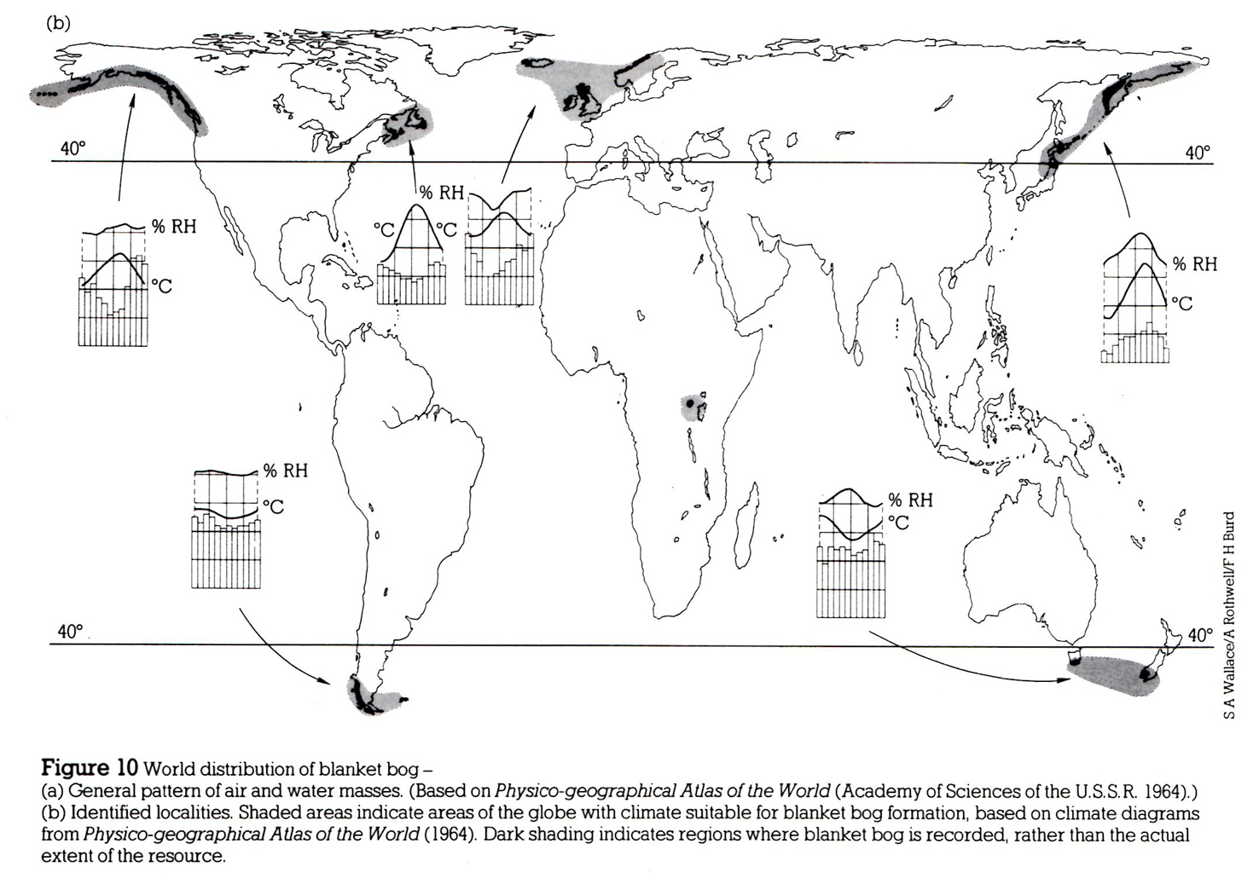
Looking at Tierra del Fuego,
for example…
From Lindsay et al. (1988)

Slide 23
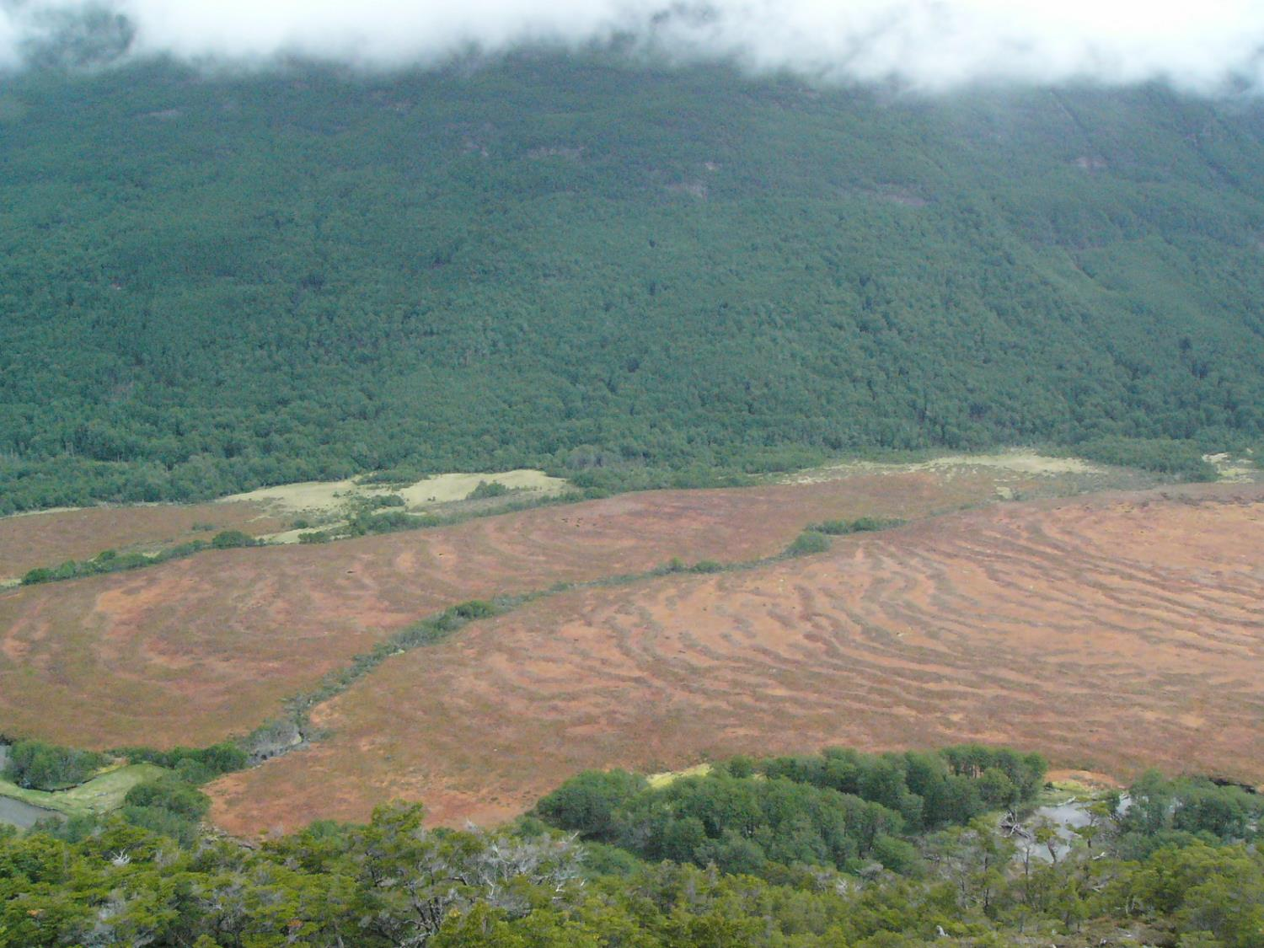
Dominating the valley bottoms of the Tierra del Fuego landscape, we find extensive raised bogs separated by stream-courses that support ribbons of woodland.

Slide 24
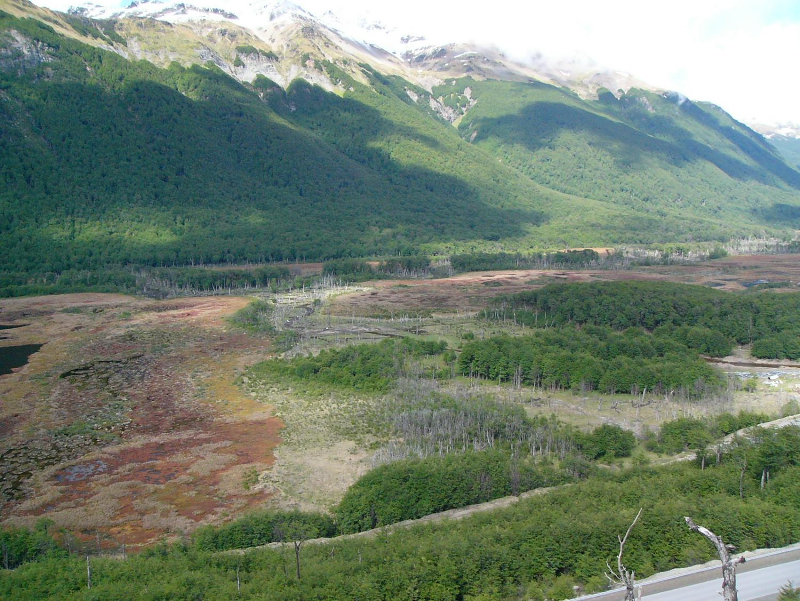
Where there is more extensive water movement or mineral flushing, woodland cover expands and thus helps to pick out such areas within the valley bottom.

Slide 25
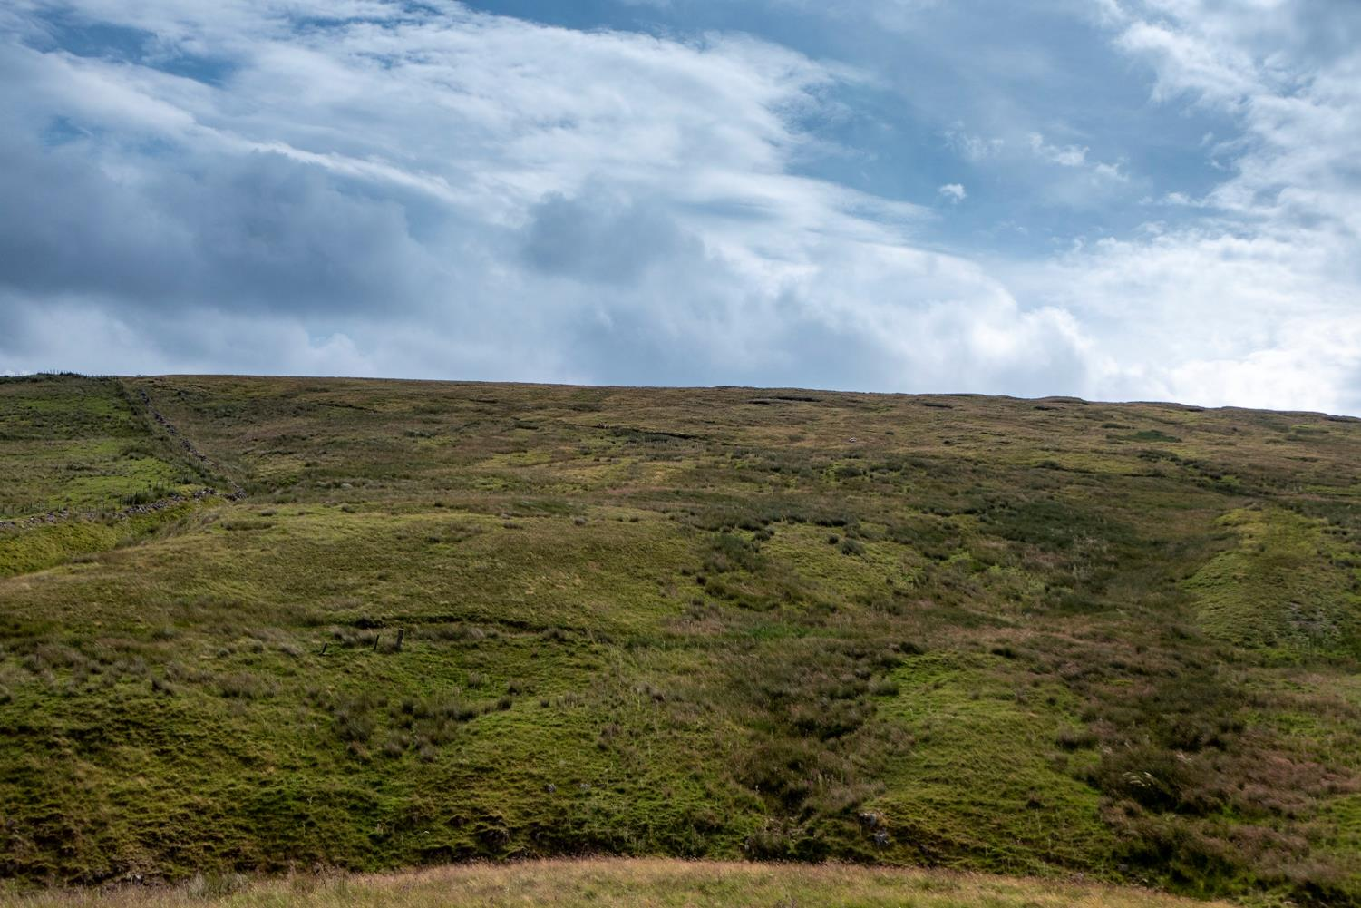
Similar opportunities for woodland cover exist within our blanket bog areas, such as these Juncus-rich flushes running off the main blanket bog plateau.

Slide 26
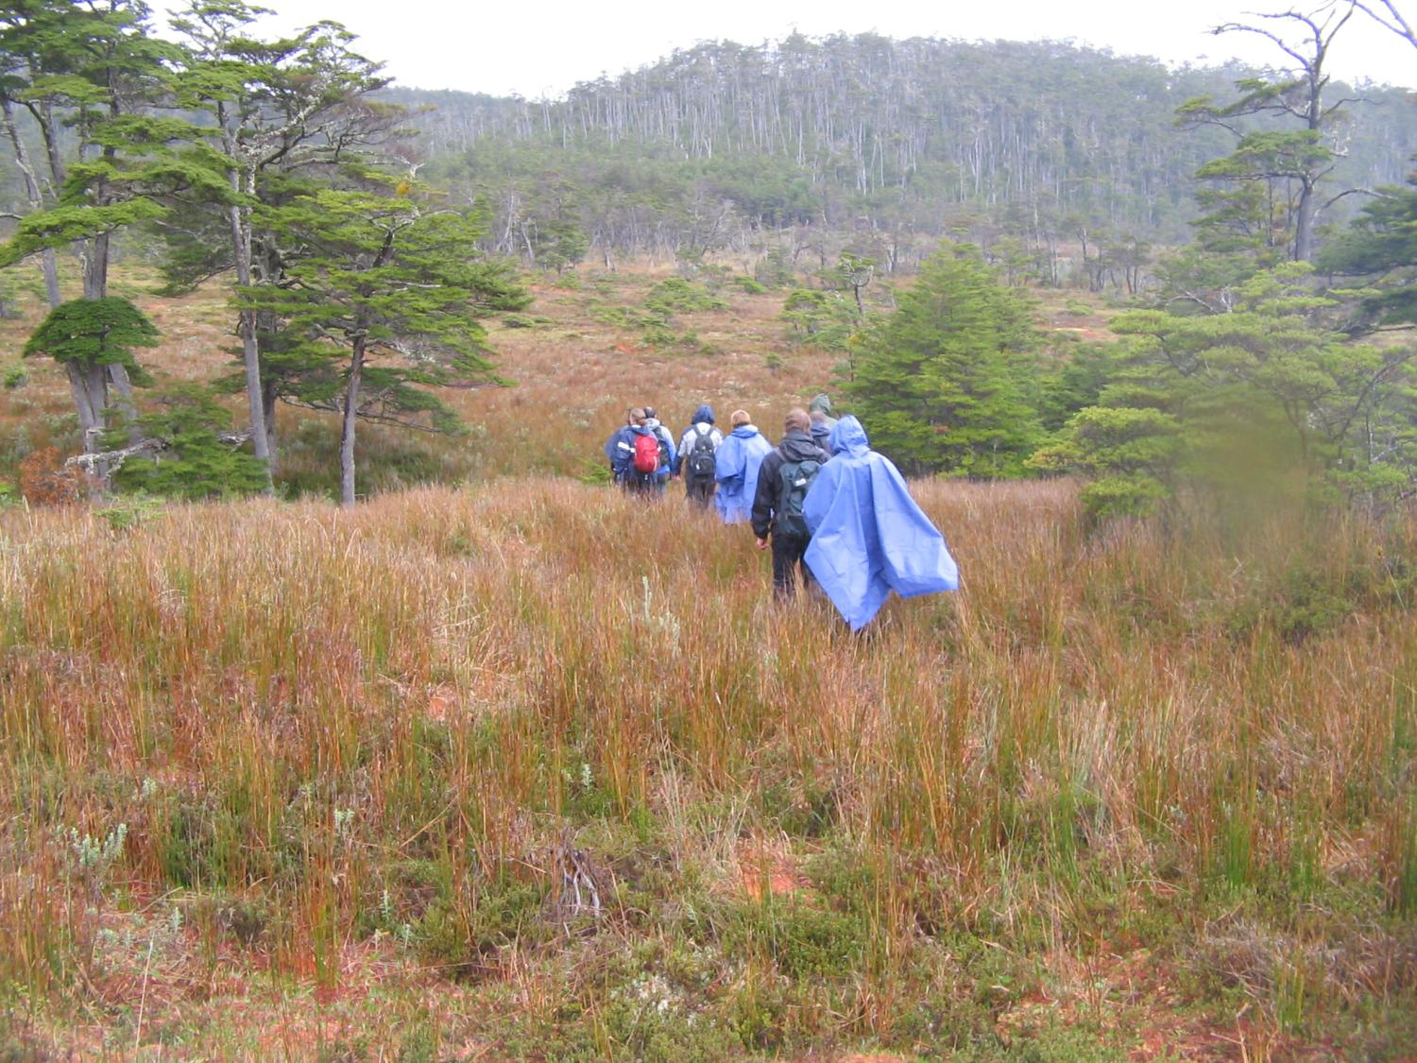
Back in Tierra del Fuego, walking up the slopes towards a broad watershed summit, various terraces of gentler ground are dominated by open mire with scattered stunted trees, while ahead of us a much steeper slope is dominated by tall dense woodland.

Slide 27
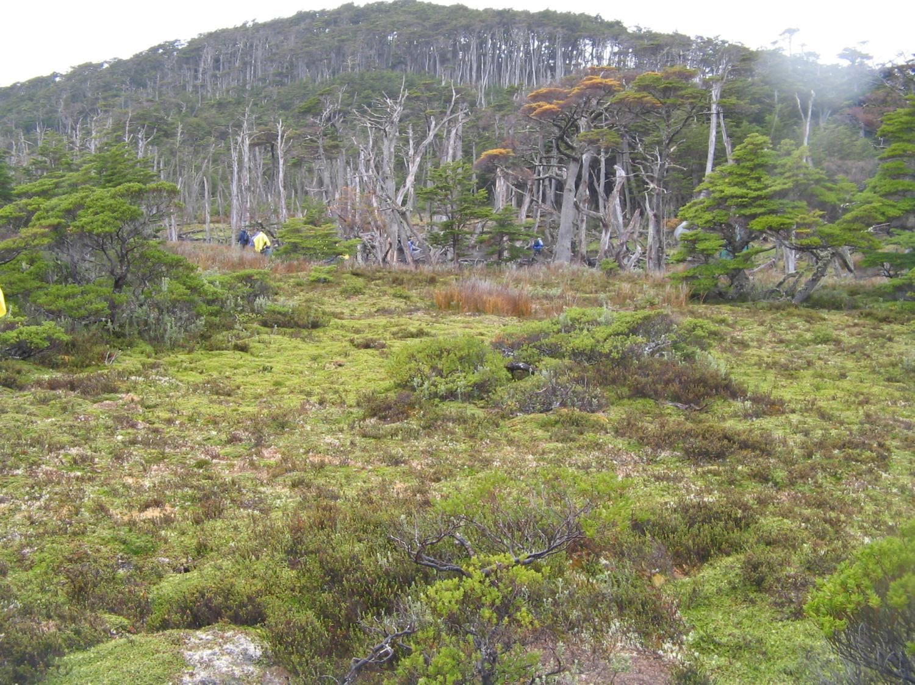
In Scotland, such dense woodland would today be plantation forest imposed on the pre-existing peatland ecosystem and there would be little mire habitat remaining beneath the forest canopy…

Slide 28
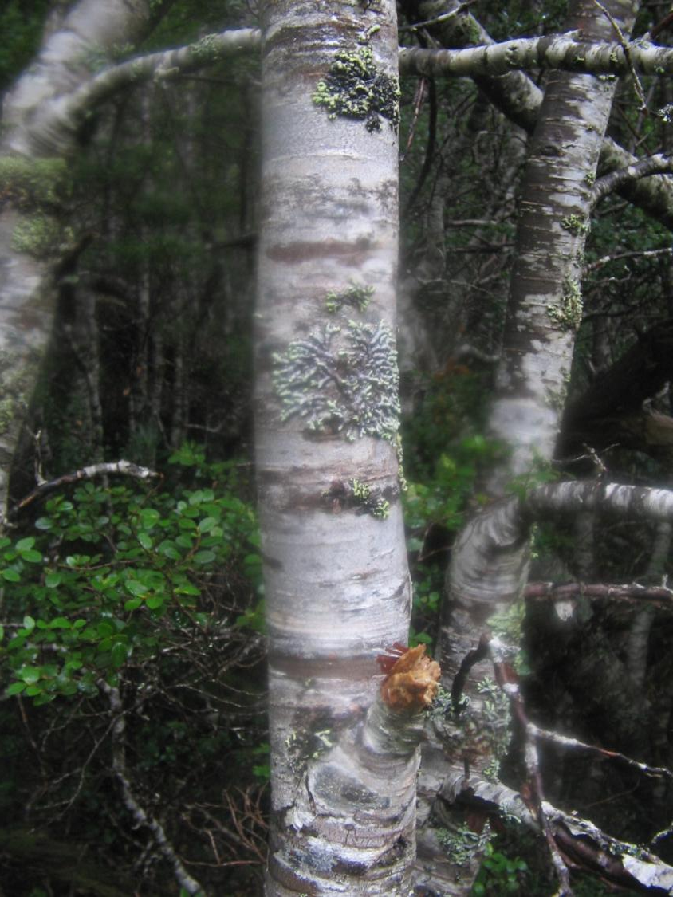
Once in this woodland the density of the trees and the substantial nature of many trees becomes evident…

Slide 29
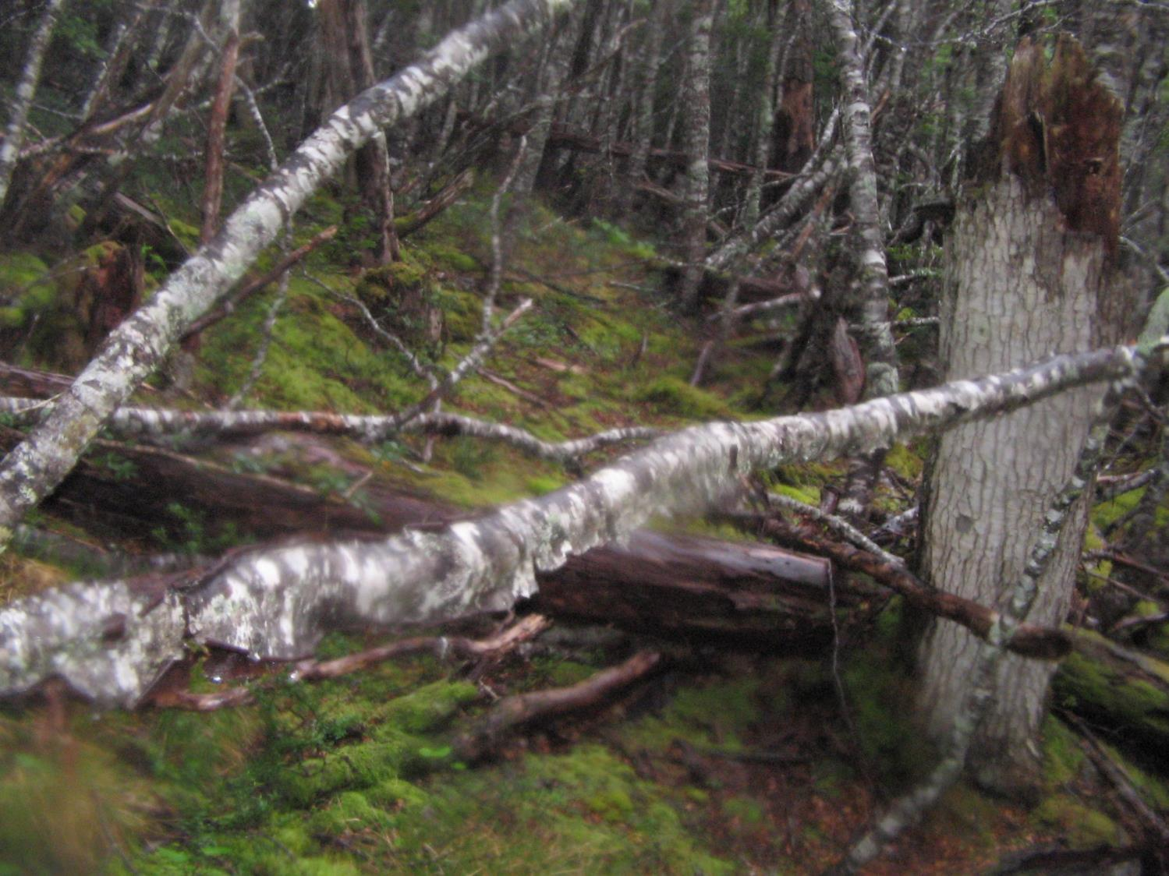
…but the woodland floor is a mass of fallen branches and broken stumps embedded within a continuous carpet of peat-forming moss. The peat here may be 1 m or more in depth, having some similarities with the wood-rich peat of tropical peat-swamp forest.

Slide 30
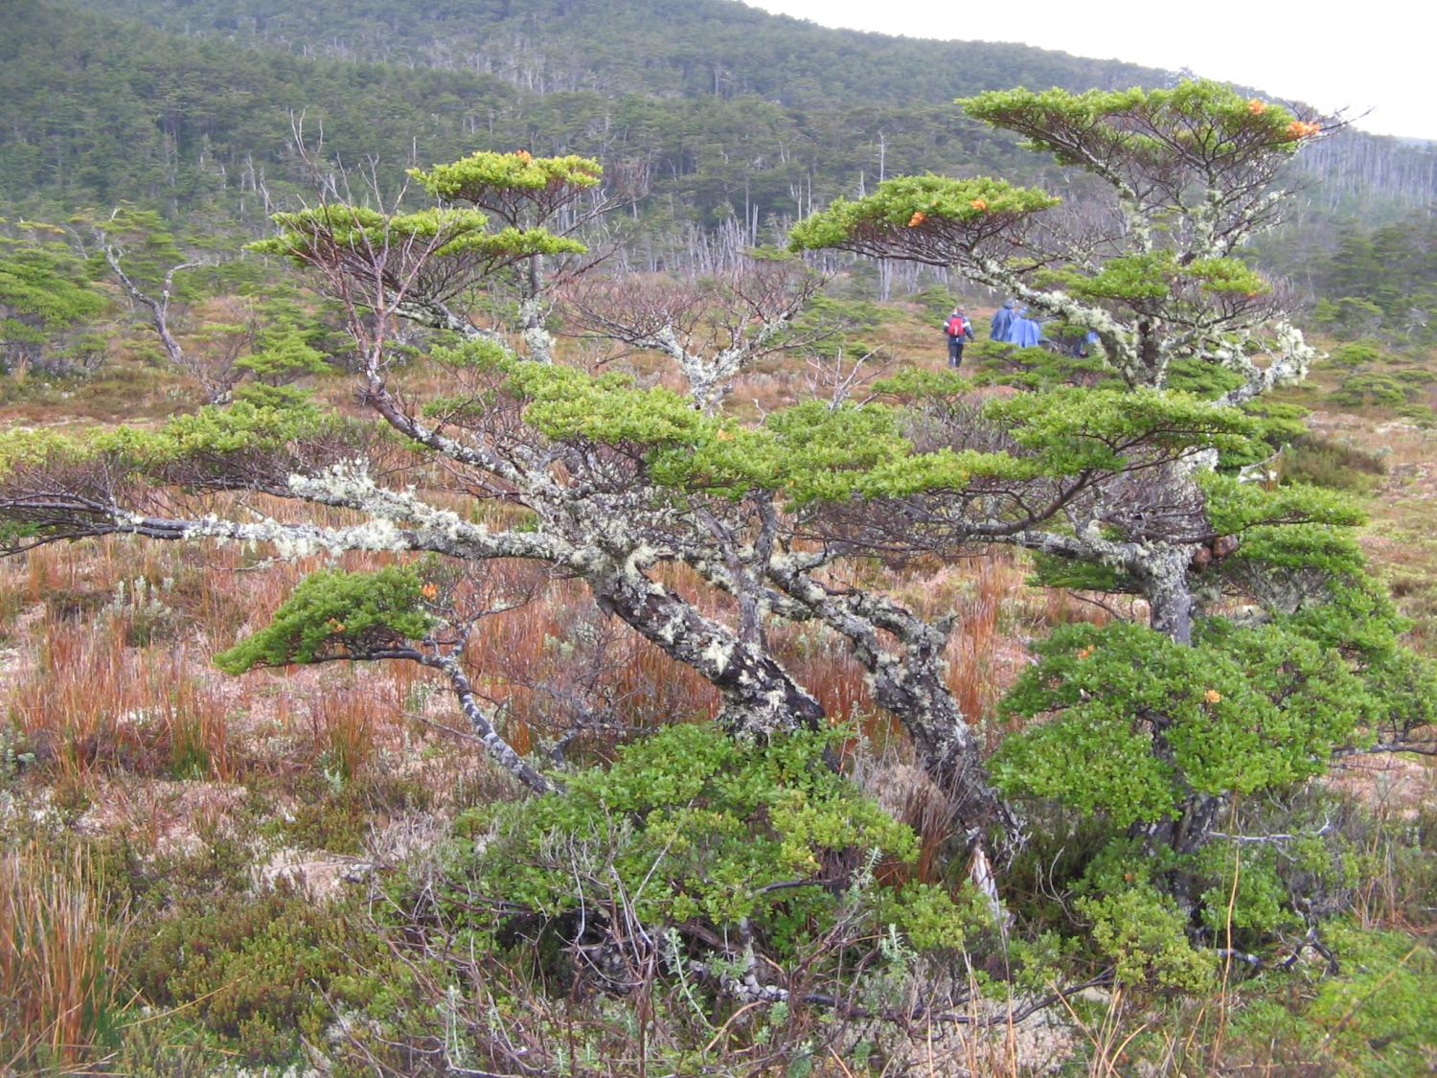
Emerging from the dense forest of the steeper slope, an area of more gently
sloping ground is again characterised by open mire with scattered stunted
southern beech (Nothofagus)…

Slide 31
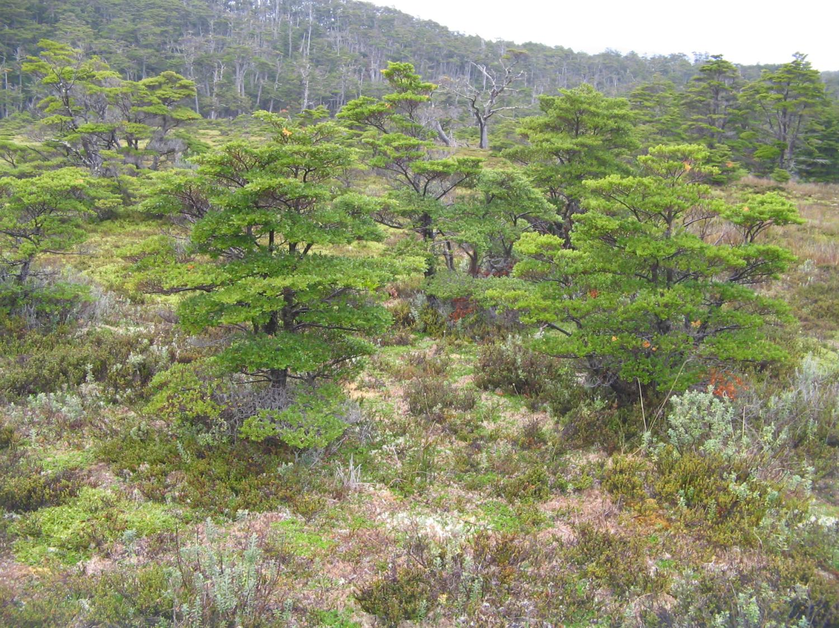
…but as the slope increases once more, tree cover also increases. Ahead of
us we can see another steep slope with another band of tall dense forest.

Slide 32
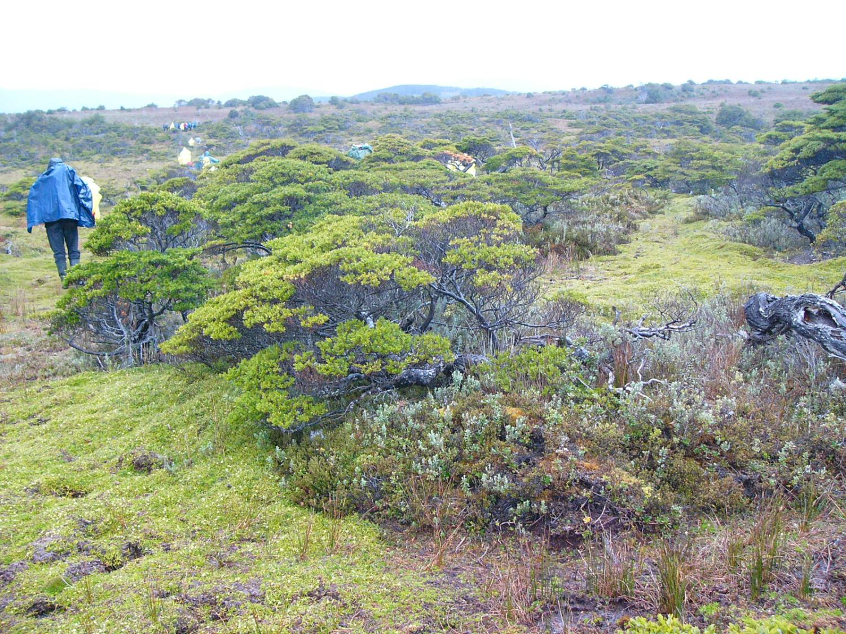
Emerging from this last band of dense forest, the landscape abruptly opens up
as we approach the broad summit of the hill. The ground is a continuous
carpet of peat-forming species (cushion plants of the southern hemisphere
as well as Sphagnum) and the peat depth is now considerable.

Slide 33
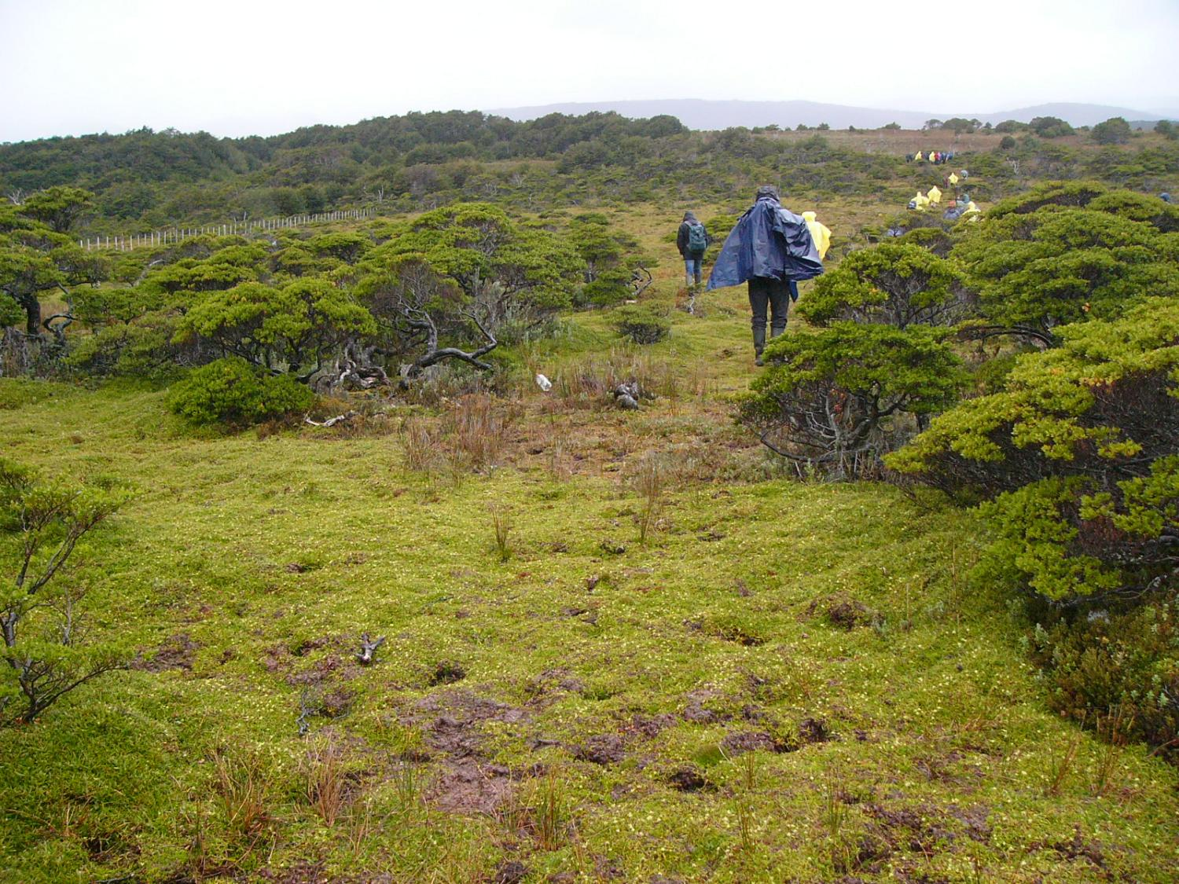
Note the evident age of these twisted, stunted southern beeches, and the
evident fact that they have grown up with the peat-forming species rather
than being planted or imposed on the peat, as a planted forest would be.

Slide 34
Emerging finally onto the hill summit, the patchwork of woodland on the slopes
below is evident, but for the entire journey up the hill slope the ground layer
was dominated by peat-forming species, even on the steepest slopes.
When stabilizing unstable materials on steep slopes, engineers use ‘soil nails’ which
penetrate down through the unstable material into more solid ground beneath. My
hypothesis is therefore that the trees of the ‘bog woodland’ on these steep slopes
act like soil nails, stabilizing the peat on such slopes. John Tallis has suggested that
the eroded margins of British blanket mire may be attributable in part to the removal
of forest cover from marginal slopes during Neolithic to Iron Age times (Tallis, 1995, p.503).

Slide 35
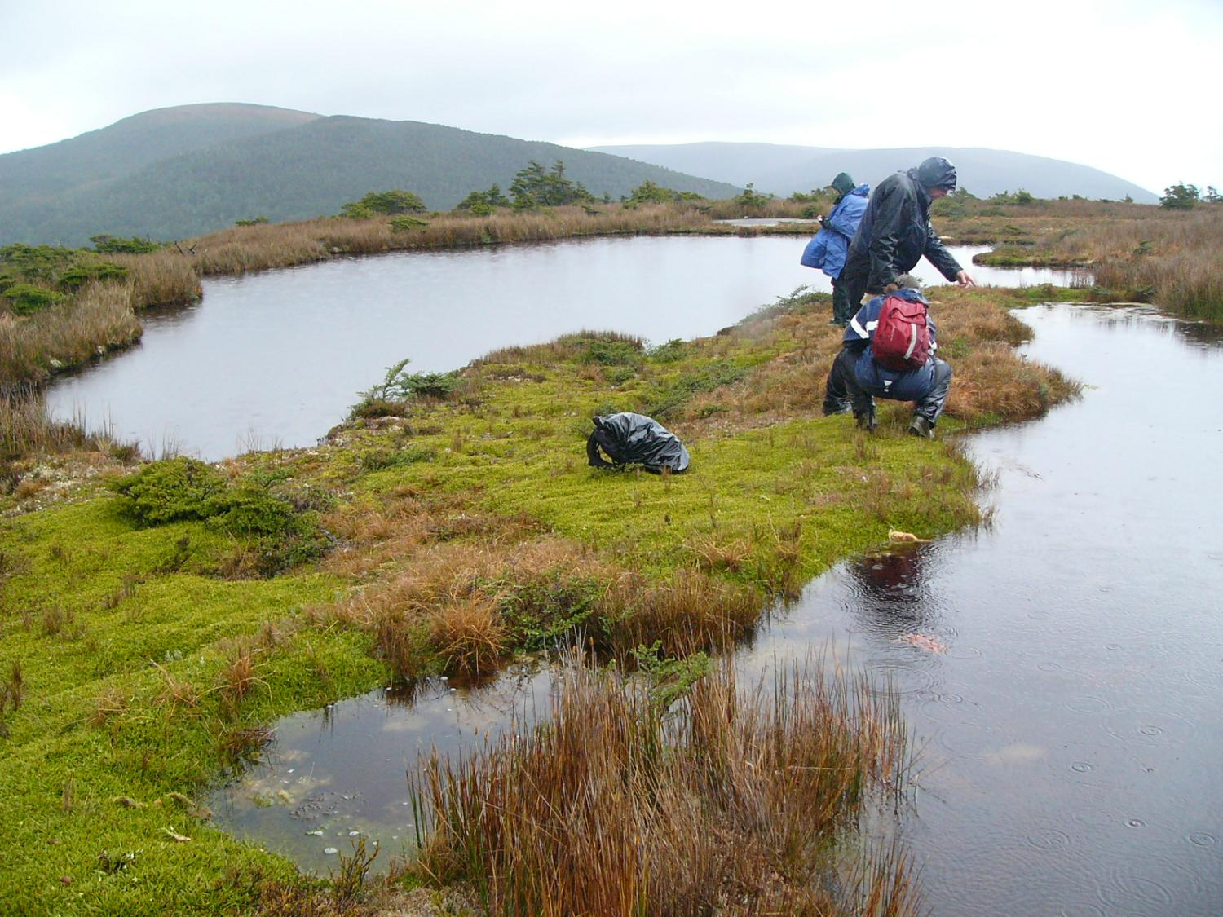
The summits of these Tierra del Fuego blanket mires are as wet and pool-dominated
as any systems found in the Scottish Flow Country, holding large quantities of water
despite the sometimes steep slopes towards the margins of these patterned areas.
Crucially, there is no sign of erosion in these systems…

Slide 36
Pearsall, in his seminal book ‘Mountains and Moorlands’, proposed a number of ways
in which blanket mire erosion may be initiated through natural processes, discussing
in particular the idea that wet peat cannot long maintain stability when its margins
consist of steep slopes (Pearsall, 1950), but he did not consider the role of woodland
cover on marginal slopes in this process, presumably because British blanket mires now
so rarely have natural woodland on their marginal slopes.
The idea, therefore, that woodland on the margins of blanket mire systems might lend
stability to such systems seemed something that was worth testing using a model…

Slide 37
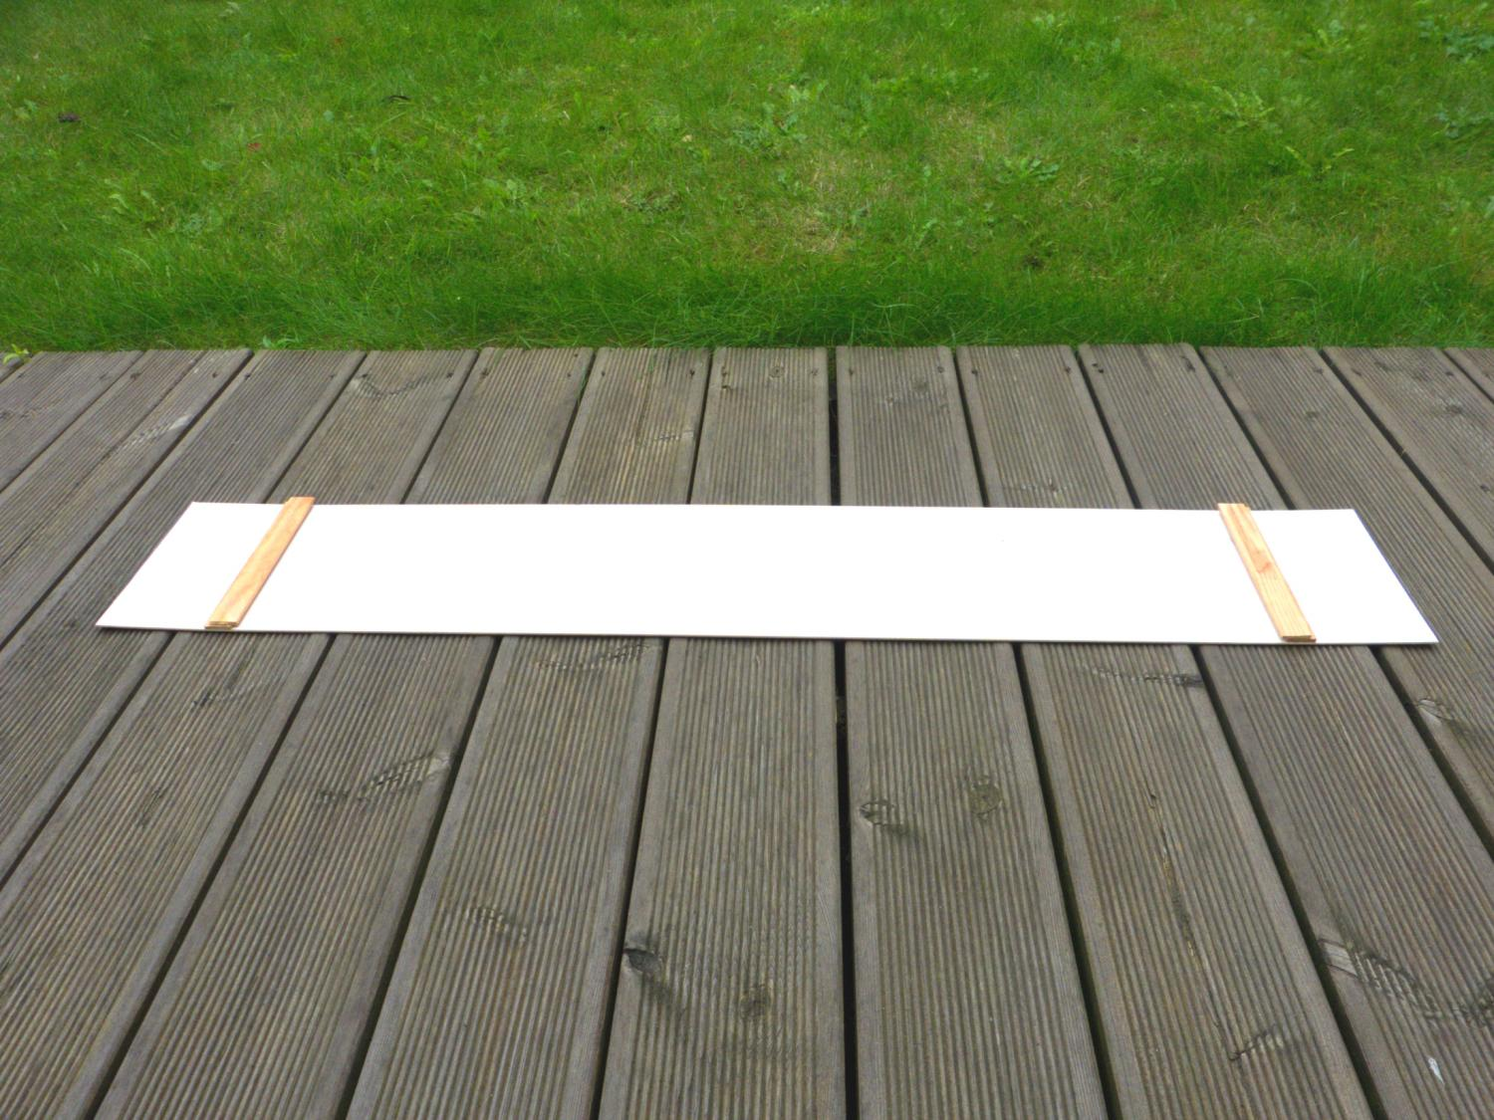
First we need a hill…….

Slide 38
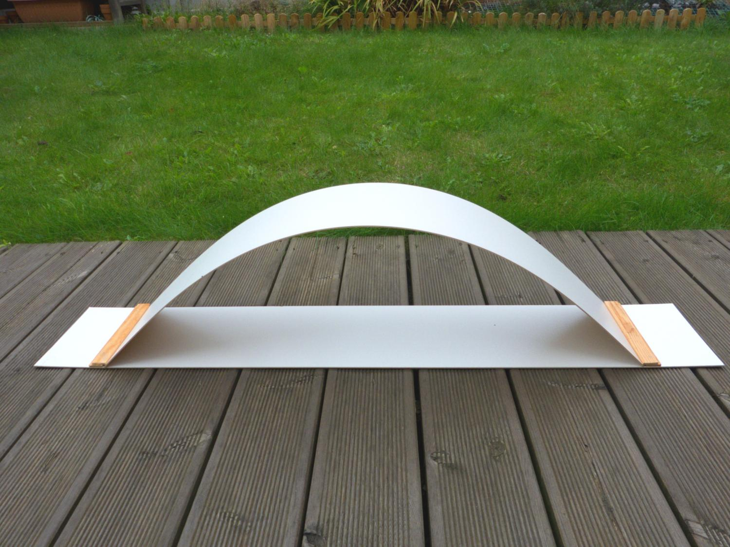
With equal slopes on either side…….

Slide 39
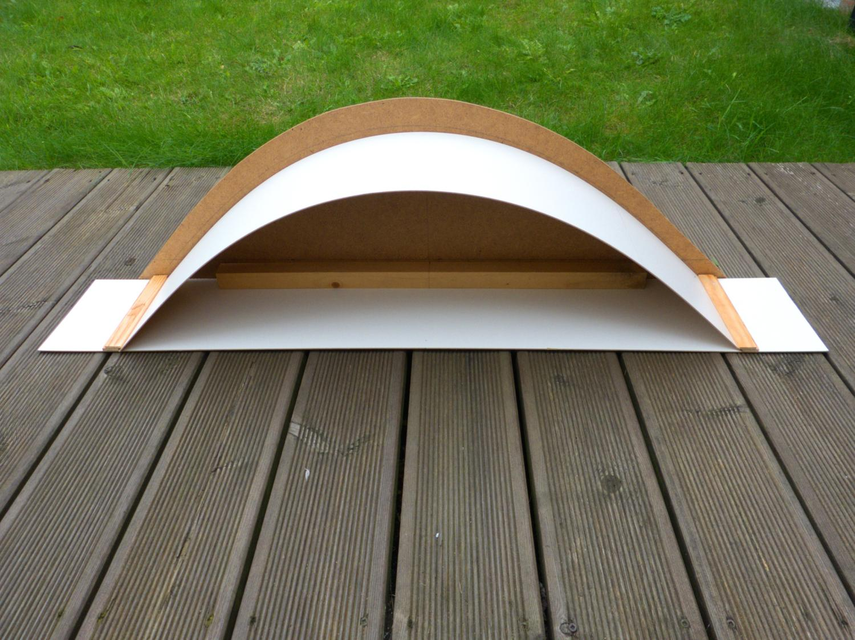
Then it needs some support to hold its shape…….

Slide 40
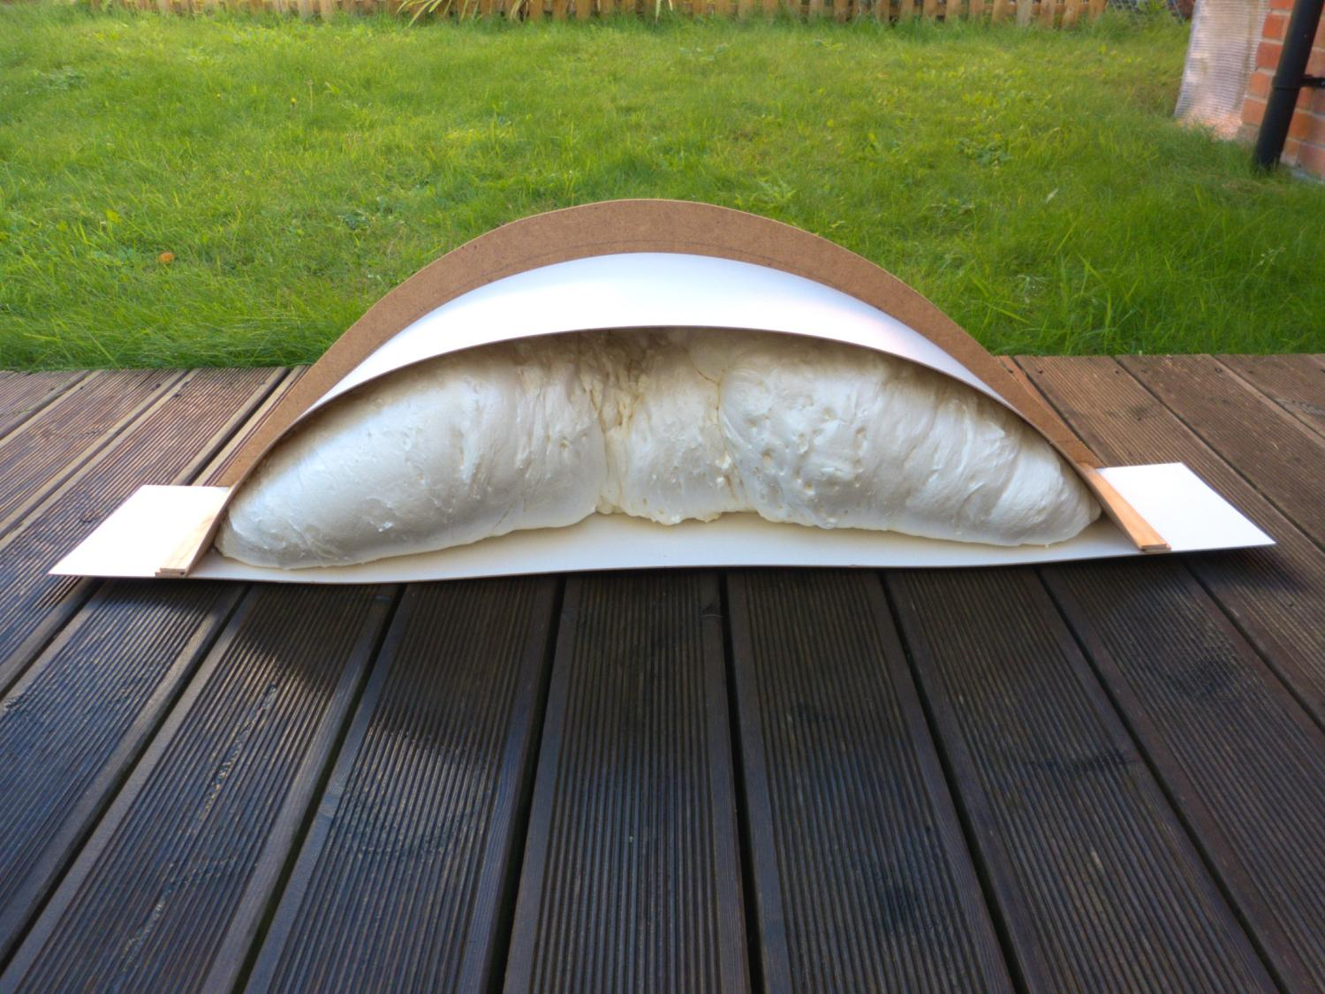
…and some filler …

Slide 41
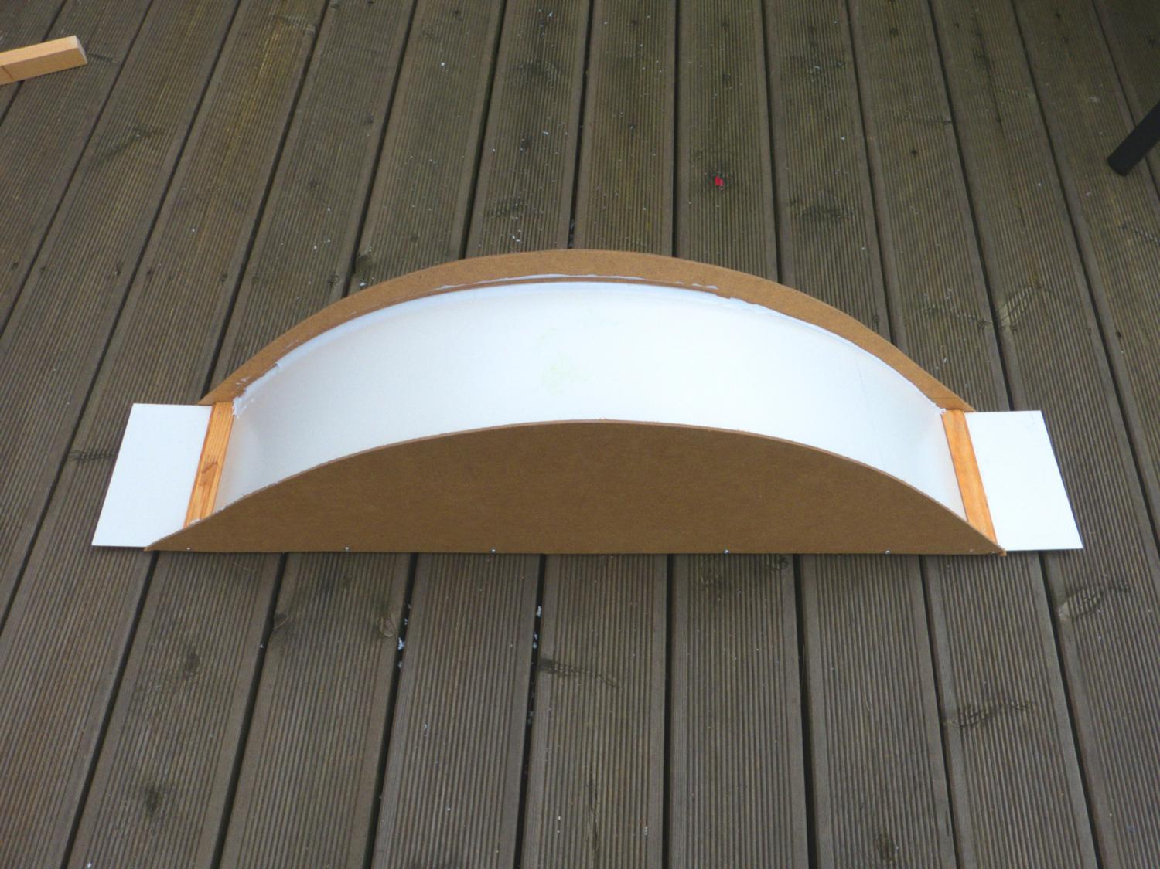
…and waterproof sealant – because bogs are wet…….

Slide 42
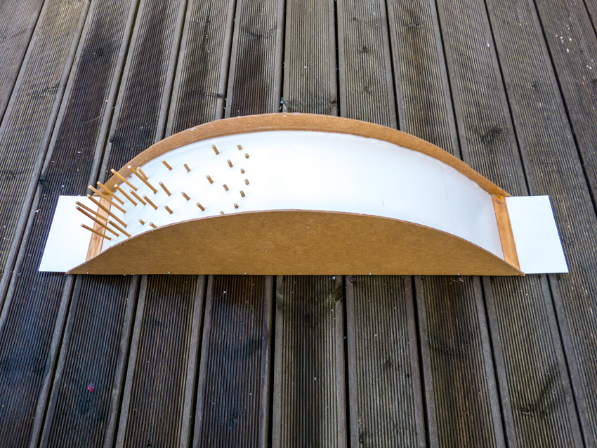
Then we grow a natural woodland on one of our slopes…

Slide 43
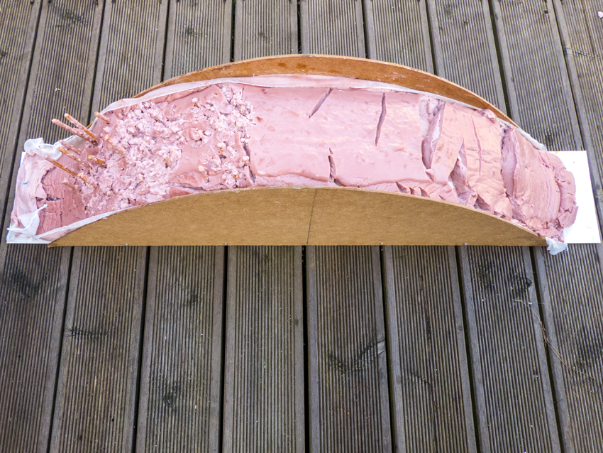
Then make a good thickness of blancmange in a mould
and, when set, lay it onto the model of the hill (blancmange
is sometimes used by geomorphologists to model the
dynamics of glaciers). Within minutes, a clear response
begins to emerge…

Slide 44
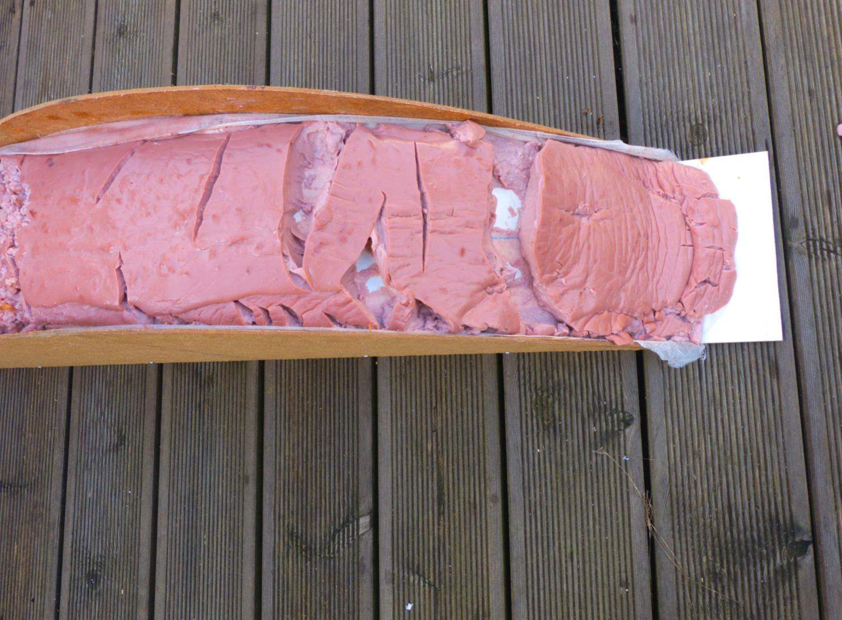
On the non-wooded slope, the blancmange begins to break into
slabs which slowly but steadily slide down the slope…

Slide 45
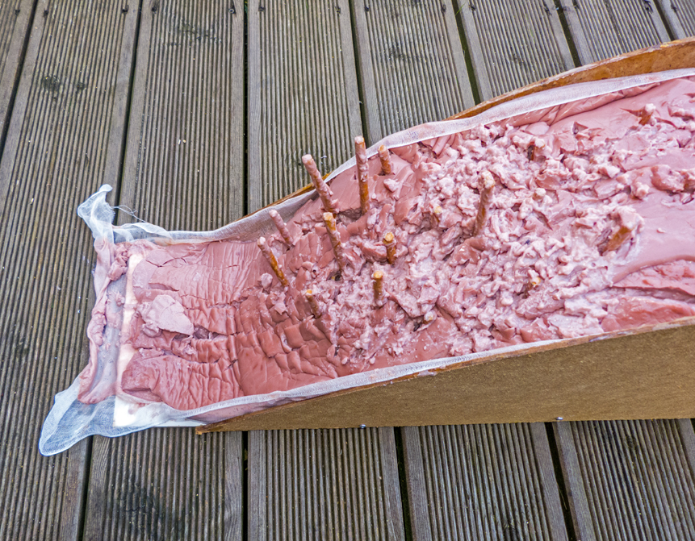
Meanwhile there is no such motion on the wooded slope, even
though the blancmange has been disrupted in the process of
laying it over the woodland…

Slide 46
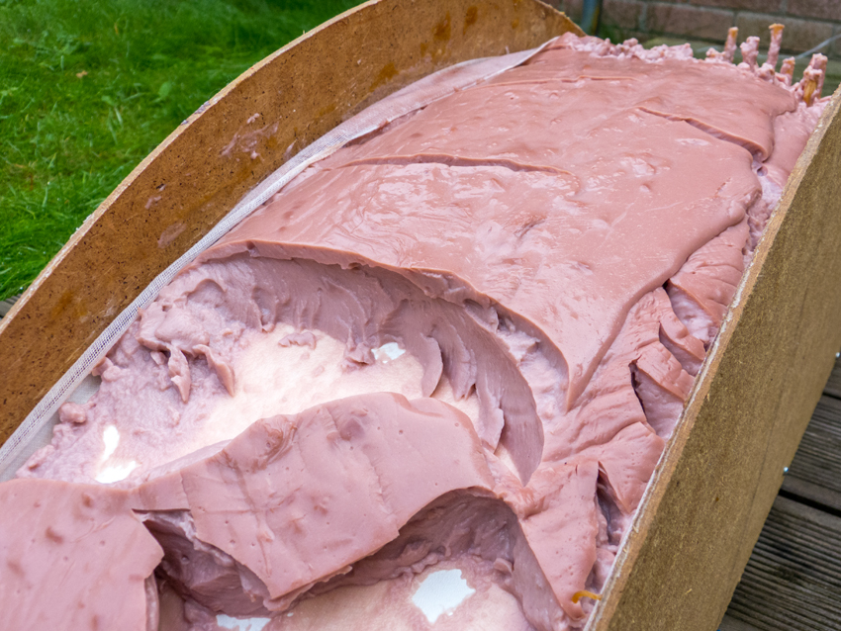
On the non-wooded slope, the blancmange continues to
peel away and slowly slide downslope…

Slide 47
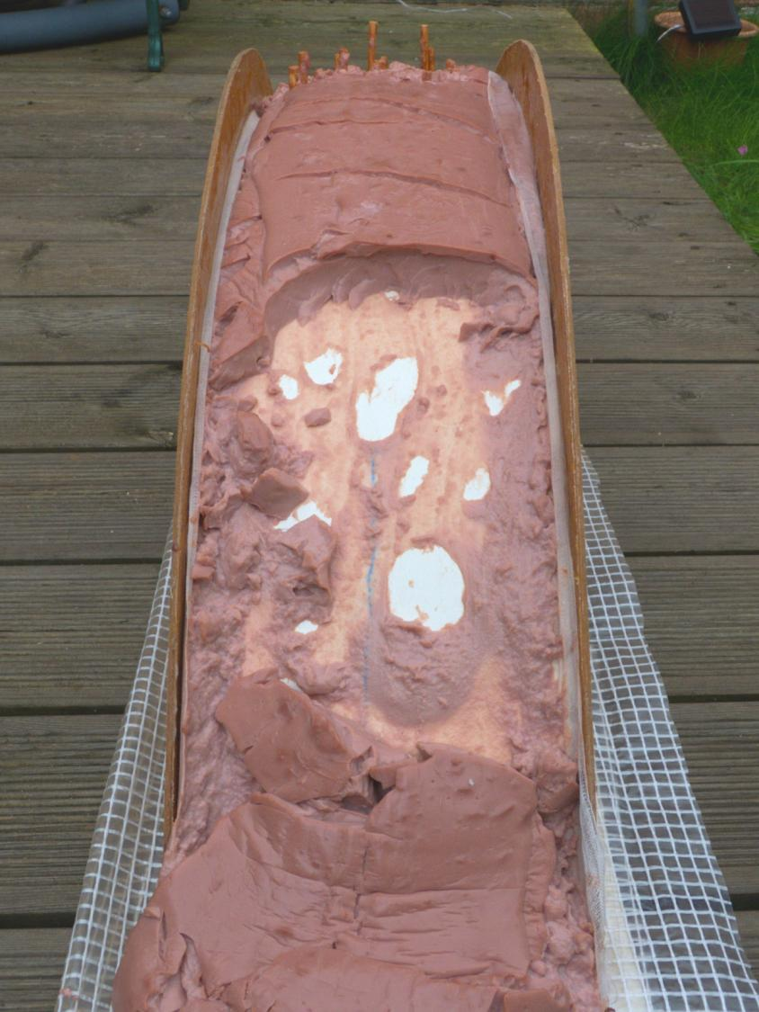
Until eventually almost the entire zone of the steeper slope has lost its blancmange layer….

Slide 48
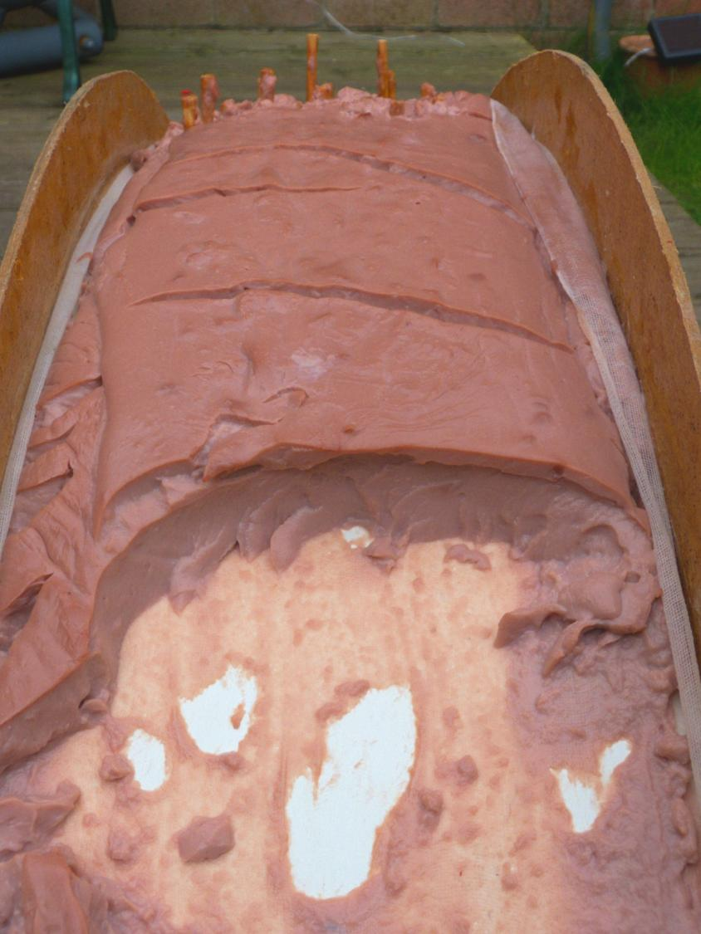
…leaving a ‘peat’ face
which resembles rather
closely the sort of peat faces…

Slide 49
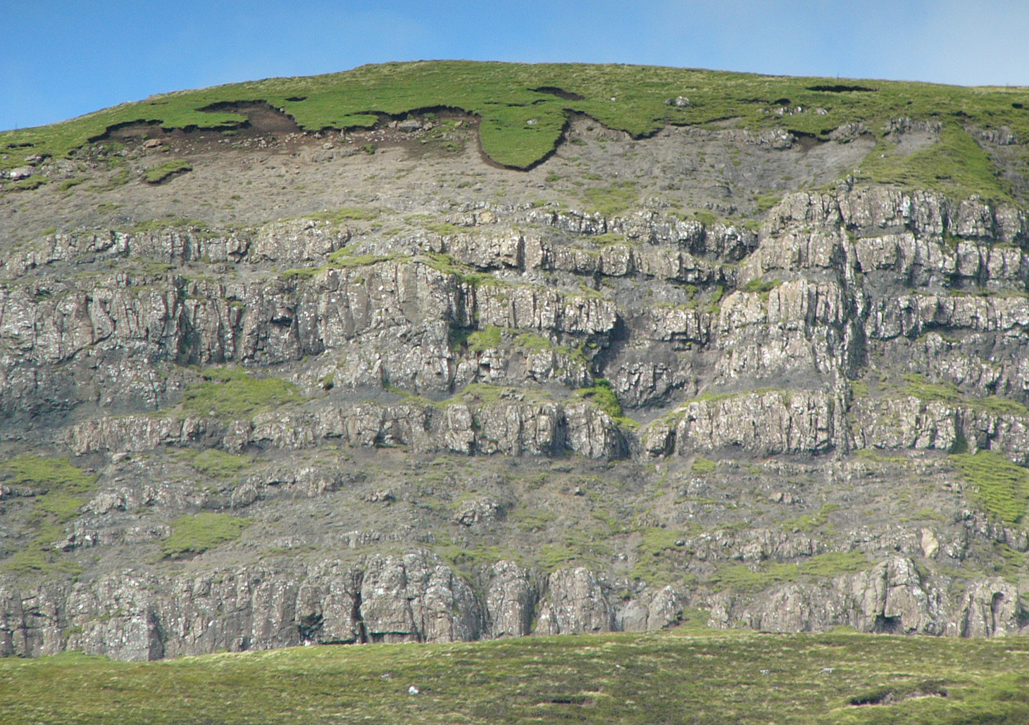
…which can be seen in a great many examples of blanket mire
across Britain…..

Slide 50
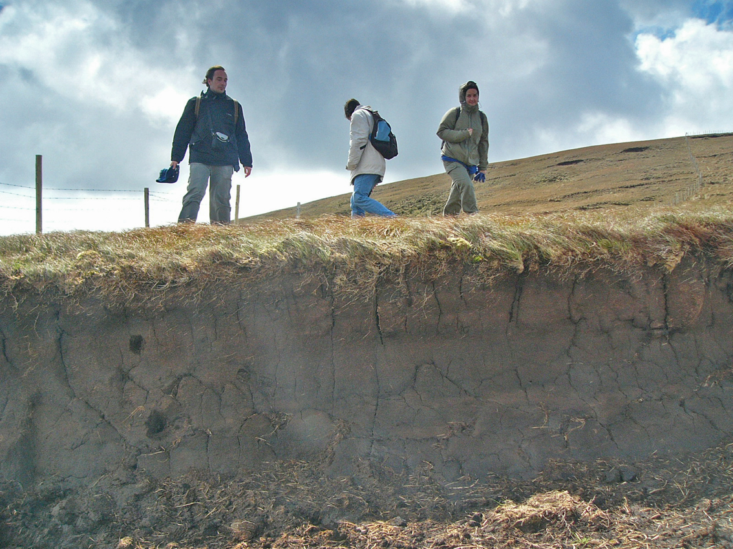
…and even in the heavily grazed blanket mires on northern Spain, which have also lost the woodland from their marginal slopes….

Slide 51
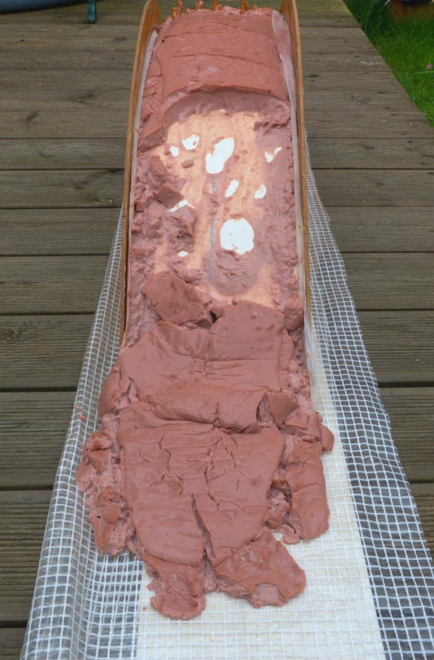
The model creates the same pattern of mass movement and downslope slumping as observed by Tallis….

Slide 52
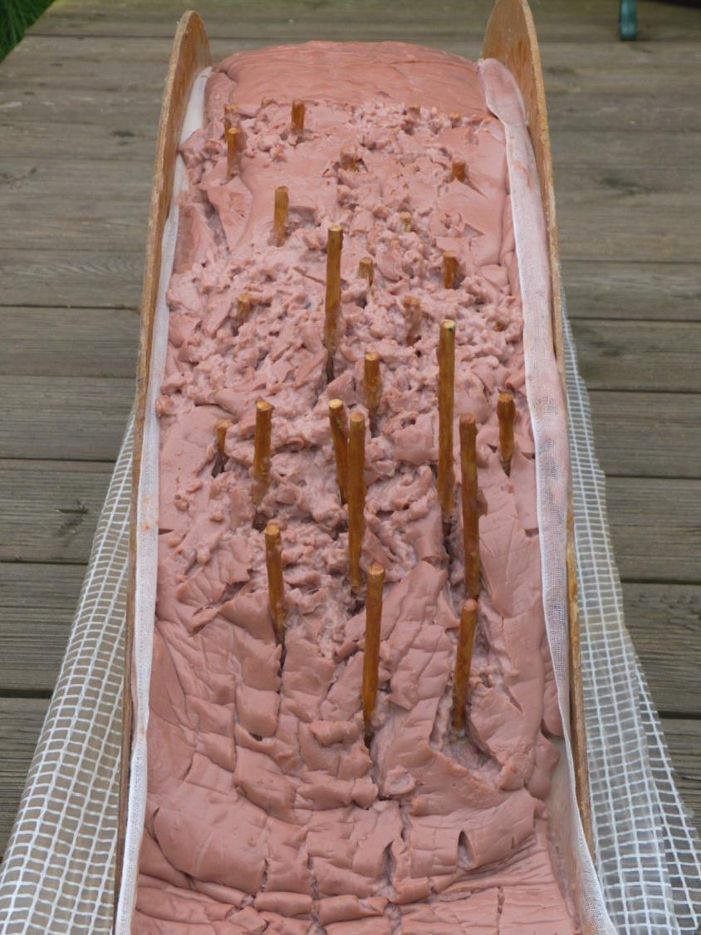
Meanwhile, our modelled wooded slope remained almost entirely stable….

Slide 53
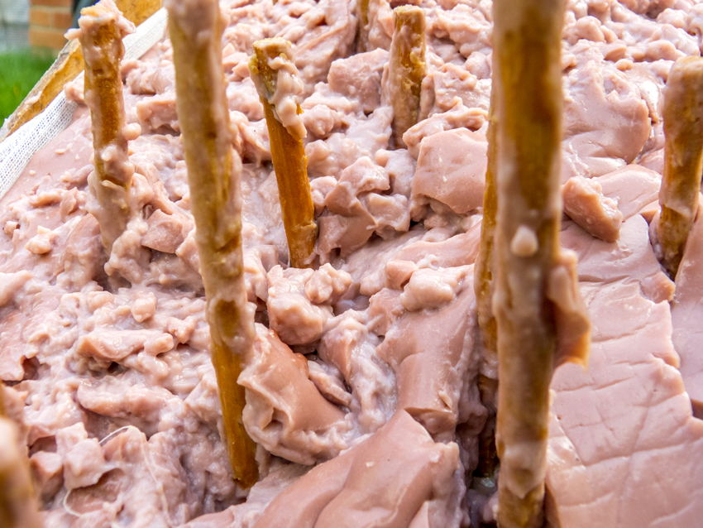
And the view within the ‘woodland’ very much resembled that which can be seen on the steeper wooded slopes of blanket mire in Tierra del Fuego.

Slide 54
…but the key thing about this woodland is that it has developed naturally with the peat-forming species – something that a planted woodland cannot do.

Slide 55
If this were indeed the original nature of our blanket mire margins, it would represent a form of true ‘bog woodland’ which had a distinctive British and Irish character linked to hill slopes rather than to the more typical low-lying bog woodland of the continent. It would have its own characteristic biodiversity, it might provide vital stability for our blanket mire margins, and it should be evident that such a mire margin could have a major impact in slowing release of waters from high rainfall events into downstream watercourses and thus have a significant role in reducing flood risk.
This exercise has looked at a model based on some fairly simple materials. Andreas Heinemeyer has observed very wisely that: “We don’t use models to describe reality, we use models to develop hypotheses. We then test these hypotheses against reality.” …and with any emerging hypothesis about bog-edge woodland and how far ‘over the top’ we can or should go, it is important to highlight some fairly important caveats…

Slide 56
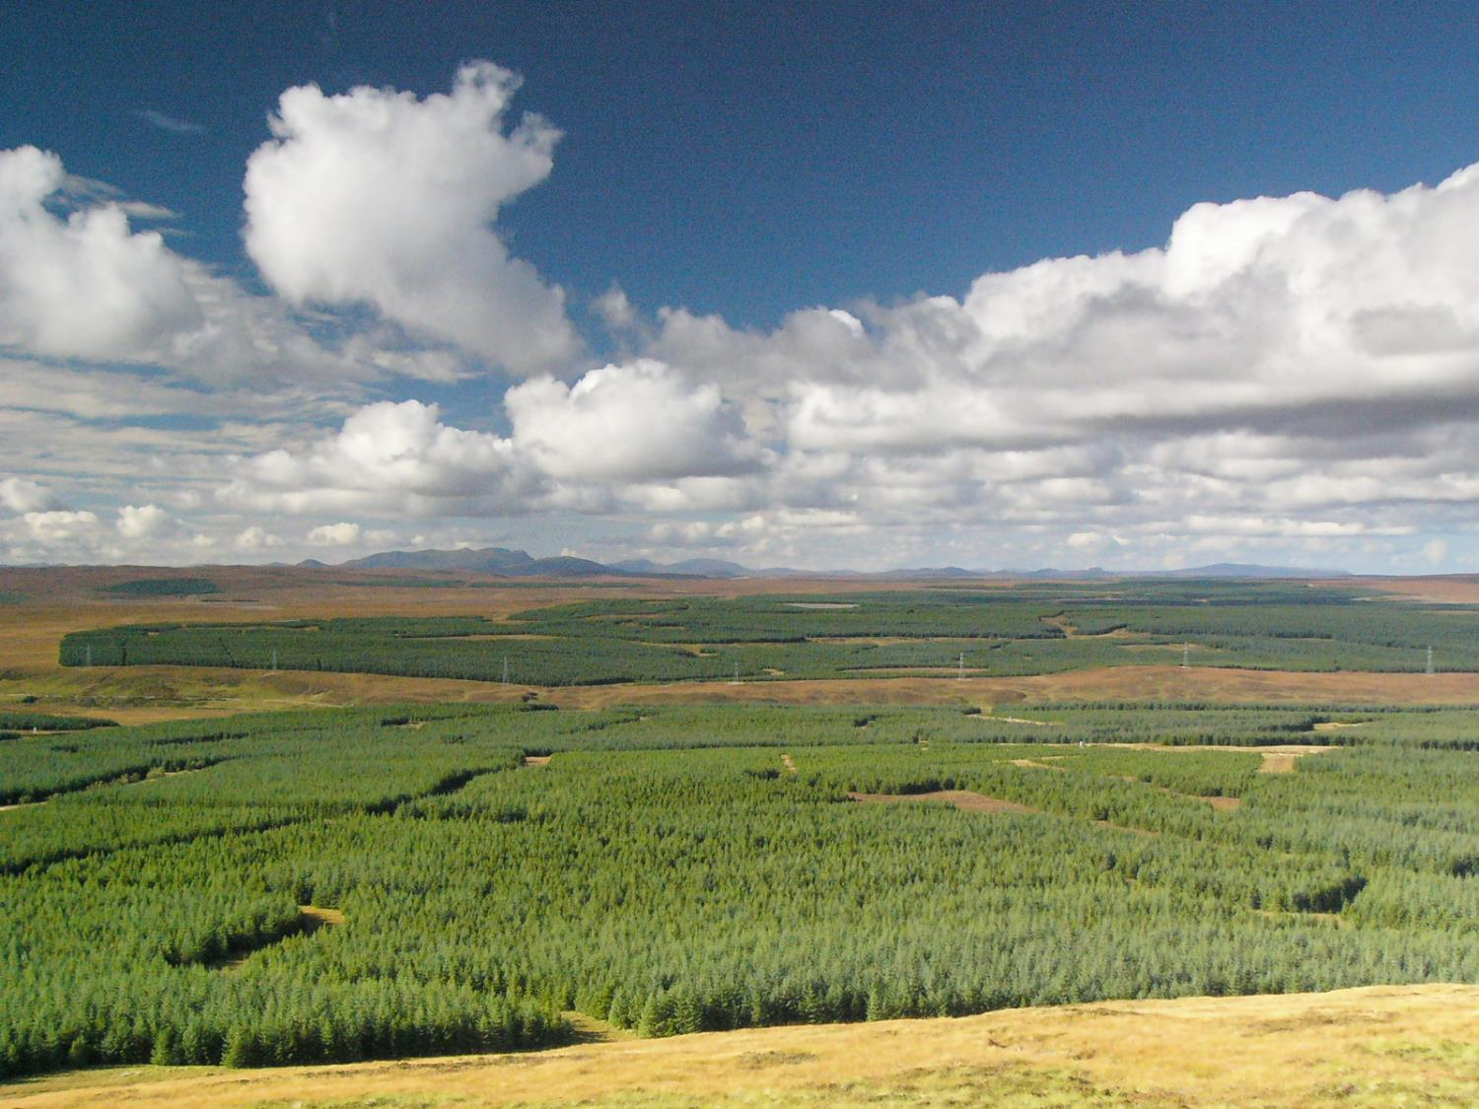
Extensive planting of conifers on blanket bog, particularly in the Flow Country of northern Scotland, has proved to be an object lesson for all of us in terms of how not to approach the whole question of trees and peatlands. Personally, I would strongly advocate the encouragement of natural woodland regeneration by a reduction in grazing pressure and cessation of burning regimes. I do not think that active planting is the right course of action – for several reasons. Firstly, we are not the best judge of precisely where a tree – and what species of tree – will survive and thrive in any given location.

Slide 57
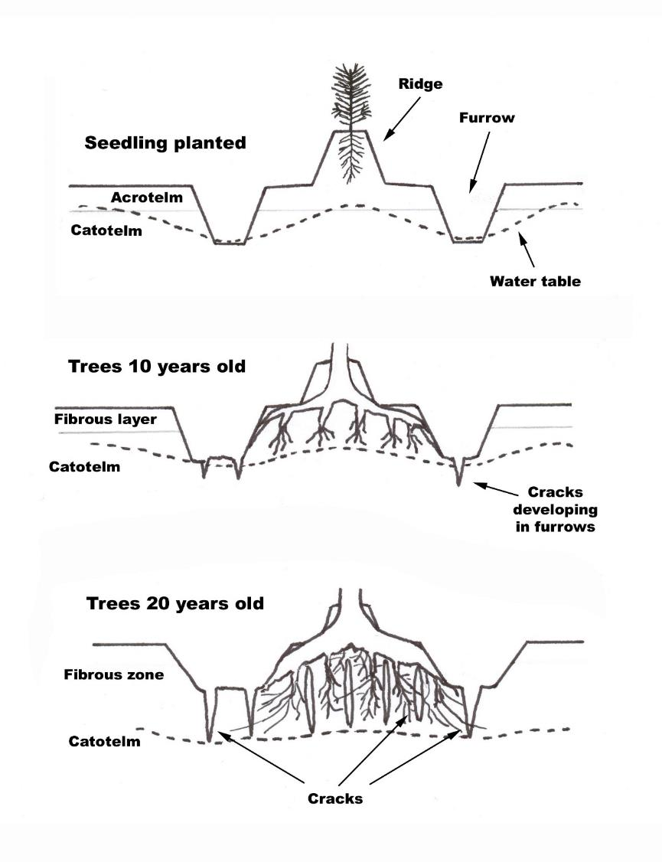
Secondly, imposing a tree inappropriately on a given area of peatland can lead to unintended consequences for the peat – consequences such as drying, shrinkage and cracking of the peat.

Slide 58
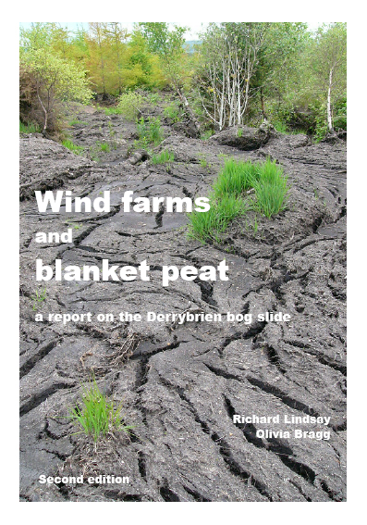
These consequences can be devastating on peat-covered hillslopes, as illustrated by the massive peat slide that occurred in Co. Galway, Ireland, in 2003

Slide 59
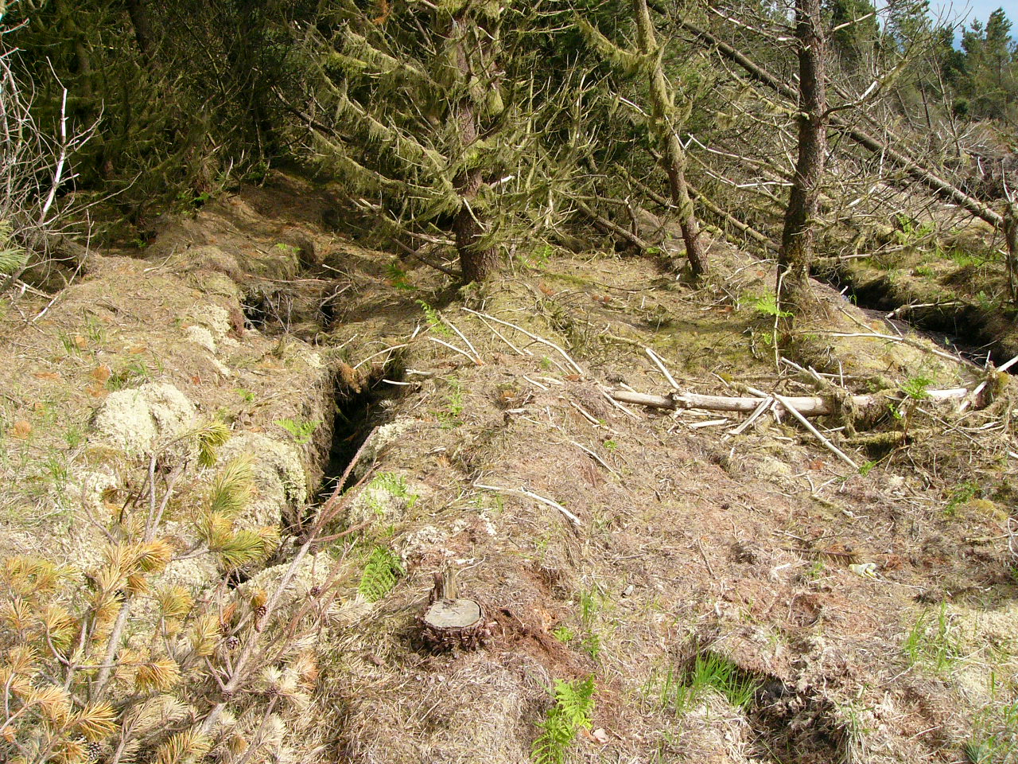
A windfarm road was being constructed through a conifer forest planted on hillslope peat. Road construction activities caused the peat to begin sliding, but the presence of the forest made this much worse as the peat began to ‘unzip’ along cracks which ran between the lines of planted conifers.

Slide 60
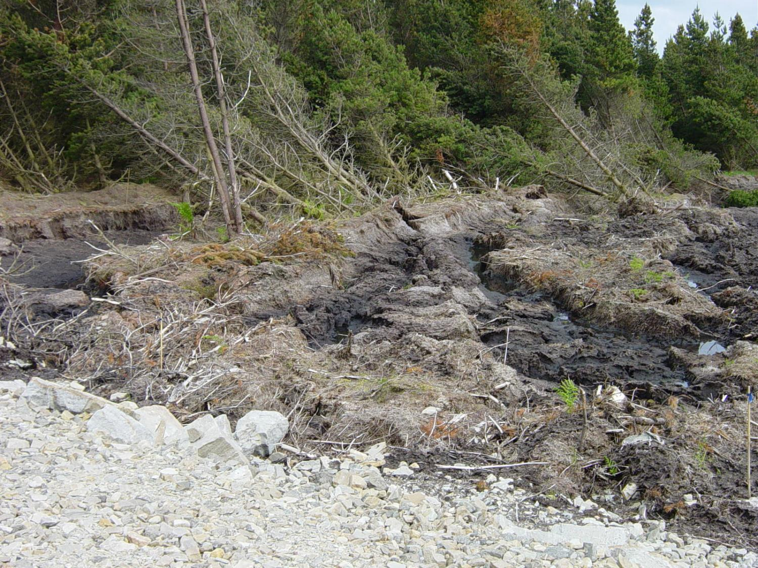
Whole blocks of peat began sliding down the hillside….

Slide 61
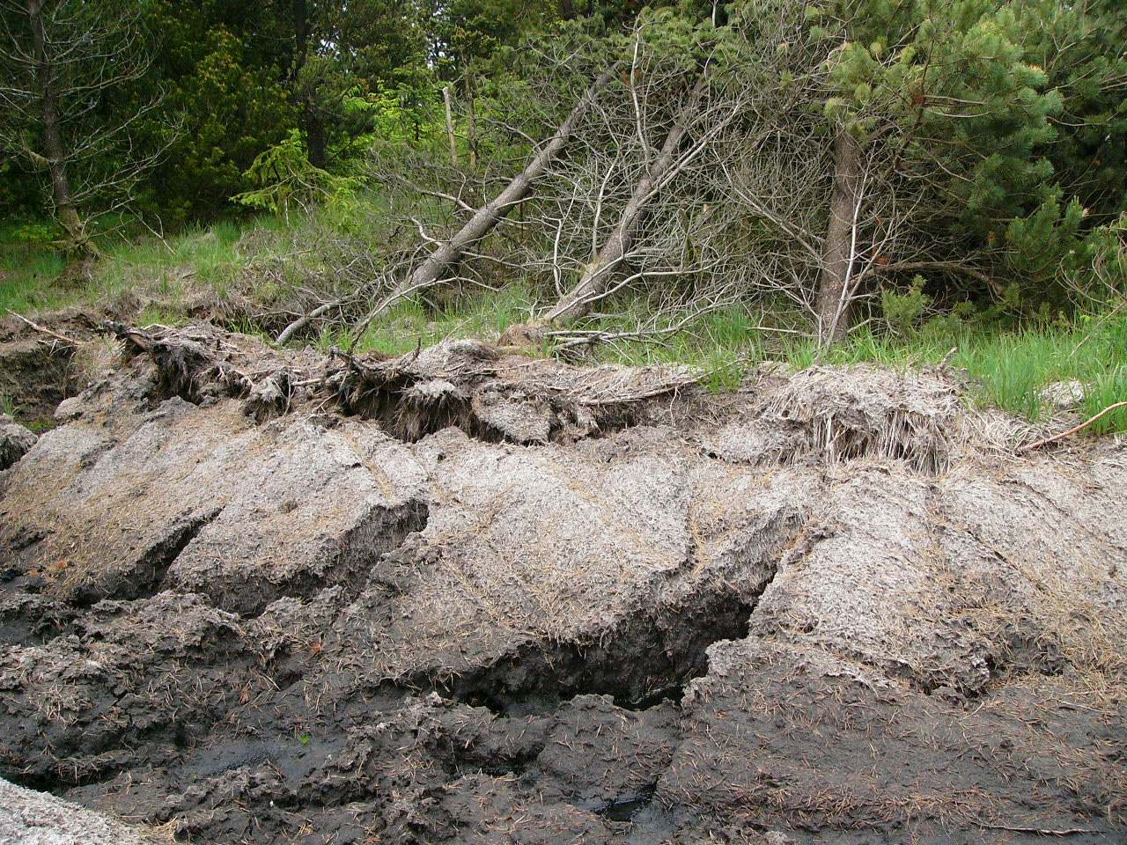
…each block shearing off from the next block along the lines of cracks that had developed, and the shallow rooting of the conifers provided no anchoring points into the mineral soil beneath to hold the peat in place.

Slide 62
Over a period of a few days, 2 km of the hillside slid slowly downslope (right red arrow), then the rains began and for almost two weeks a torrent of liquid peat poured down the hillside and travelled 20 km down the river system, destroying the water supply for the local town of Gort. It could have been worse; if the peat has slid the other way (left arrow) it would have been directed straight towards the village school…

Slide 63
Badly implemented schemes involving trees on hillslope peat can have devastating consequences, and the danger of this is likely to increase with changing climate patterns. More powerful convective storms in summer and heavy continuous rain in winter mean that conditions capable of triggering mass movement of peat are already increasing. Equally, though, this makes more compelling the argument for re-establishing natural woodland cover on the margins of our blanket bogs through encouragement of natural woodland regeneration.
Europe’s changing flood patterns, showing how upland areas of the UK are already experiencing higher rainfall:
https://www.nature.com/articles/s41586-019-1495-6
(see ‘Figures’ tab, Figure 1)

Slide 64
I can see other challenges, though. While such heather-covered slopes as these in the eastern Highlands would probably respond most rapidly to a regime of reduced grazing and no burning to encourage natural woodland regeneration, some land-use interests will be keen to see such slopes remain open…

Slide 65
…for grouse shooting and deer stalking, and of course hill-sheep farming. The conversation will thus need to be one that engages a wide variety of interest groups.

Slide 66
Much of this talk has been concerned with sloping ground where peat tends to be thinner, but thin peat is still important. It tends to be overlooked or dismissed as ‘marginal, both literally and figuratively.
It is a big mistake to think about thin peat in this way, partly because thin peat is more extensive than deep peat, but also because in terms of carbon stored, thin peat is our tropical rainforest…
Primary tropical rainforest contains up to 300 tonnes of carbon per hectare:
https://primaryforest.org/news/a-new-infographic-and-primary-tropical-forests-and-climate-change-mitigation/
…though this figure is generous and much tropical rainforest contains less than this:
Blais, A.M., Lorrain, S., Plourde, Y. & Varfalvy, L. (2005)
Organic carbon densities of soils and vegetation of tropical, temperate and boreal forests.
In: Tremblay, A., Varfalvy, L., Roehm, C. & Garneau, M. (eds) Greenhouse Gas Emissions — Fluxes and Processes.
Springer Environmental Science, Berlin, 155–185.

Slide 67
A thin peat of 30 cm can contain
around 300 tonnes C per hectare – equivalent to tropical rainforest…

Slide 68
…yet thin peat is more easily damaged, is more easily lost completely, than the carbon store of a tropical rainforest. Often it is lost because we don’t even think of it as ‘peat’. Any plan for bringing woodland back to these thin peat slopes needs to be sensitive to this most overlooked and under-valued part of our natural capital. We cannot point the finger at loss of tropical rainforest if at the same time we are destroying, through ignorance or design, our own equivalent to the tropical rainforest carbon store.
Thank you.

