Slide 1
Transnational Academic Mobility and Knowledge Creation:
A critical reflection on interculturality and (de)coloniality
Dr. Terri Kim
Reader in Higher Education
Cass School of Education and Communities

Slide 2
Internationalisation of Higher Education Worldwide through Academic Mobility
Total number foreign students worldwide: + 3.5 million
Inbound
1.5 million of all foreign students study in Europe
(50% global “market share”)
58% of these come from outside Europe, 38% from inside (4% unknown)
Foreign student share (of total enrolment) is about
7% in Europe.
(Source: Bernd Wächter, ACA, 2010; UKCISA, 2011)

Slide 3
There are two major processes occurring:
very rapid changes in political space, particularly the creation of regional spaces, within which transnational academic mobility occurs;
and – almost everywhere – policies are being written and implemented by international and supranational agencies.
Previous sporadic, exceptional and limited inter-national academic links have become systematic, dense, and multiple trans-national, which is especially visible in Europe. (Kim, 2009)

Slide 4
On a global scale,
We are experiencing a mass movement of academics (especially researchers) across borders at the same time as a new mode of knowledge production (Gibbon, 2003; Kim, forthcoming, 2013) and the corporatisation of universities (Kim, 2008).
HE has become an indicator of economic super-power; and universities are regarded as ‘ideal talent-catching machines’ → International students become migrant workers.

Slide 5
In the Age of Migration
The EMN project: ‘Immigration of International Students’ http://emn.fi/ajankohtaista/emn_kansallinen_seminaari_2012_-_kooste/
According to a new report by the OECD, migrants to advanced economies have generally spent longer in education than their native-born peers.
More than half of recent migrants in Canada, Australia, Ireland and the UK are HE graduates.
Over 50% of immigrants to Canada and 47% of the recent migrants to Britain have completed tertiary education, the highest levels among rich countries
(OECD, 2012; Economist, 6 Dec. 2012).

Slide 6
Internationalisation of the Academic Profession in British Universities
27% of full-time academic staff appointed in 2007/08 came from outside the UK (Kim and Locke, 2009).
41% of UK university full professors have foreign citizenship (Teichler, 2010).
Within the UK, the highest numbers of new appointments from the EU are: Germany 4200, Ireland 2895, Italy 2695, France 2340, Greece 1905, and Spain 1570.
From outside the EU, the highest numbers of appointees are USA 2950 (2380 academic staff + 570 researchers), China 3730 (2280 academic staff + 1450 researchers), and India 1900 (1330 + 570).
On the basis of current trends, it has been estimated by the Universities UK that the overall proportion of international academics employed in British universities will rise to 50% in 20 years
(Source: Universities UK, Policy Brief Talent Wars, 2007, p. 10).
The rise of a new transnational academic tribe &
the de-nationalisation of the British academic profession? (Kim, 2009)

Slide 7
As argued by Ainley (1993),’skills’ formerly understood by many as complex social processes have become de-contextualised and de-constructed into finite, isolable ‘competences’ to be located as the property of the individual, who then carry them, luggage-like, from job to job and also across spatial boundaries (Ainley 1993: 357).
The same logic is applied to transnational mobility of academics and the types of knowledge they carry; moving from transactions to transcendence - to making something personal.

Slide 8
My analytic frame of reference draws on:
C. Wright Mills’ Sociological Imagination and Paul Ricoeur’s Time and Narrative and Narrative Identity.
to delineate the intricate connection between the patterns of individual lives and social structures and movements and the course of world history in an attempt to:
“understand the larger historical scene in terms of its meaning for the inner life and the external career of a variety of individuals.” (Mills, Sociological Imagination, 1959, p. 5)
Thus historical time becomes human time
“to the extent that it is articulated through a narrative mode, and narrative attains its full significance when it becomes a condition of temporal existence.” (Ricoeur, Time and Narrative I, 1990, p. 52).

Slide 9
Phenomenological approach – as an instance of
re-living rather than ‘re-porting’:
“Phenomenology is a project of sober reflection on the lived experience of human existence - sober, in the sense that reflecting on experience must be thoughtful, and as much as possible, free from theoretical, prejudicial and suppositional intoxications.”
(Max van Manen, ‘Phenomenology of Practice’ In Phenomenology & Practice, Vol. 1, No.1, 2007, p. 12)

Slide 10
The inter-war period – extreme politics of Nazism and the mobility of academics for ‘liberty’ (1918-1939)
The contemporary period - the extreme politics of neo-liberalism and the mobility of academics for the pragmatics of ‘optimization’ (1990-2012)
The complex process of knowledge creation and innovation should be informed by the involvement of the personal, biographic dimensions of mobile academics’ engagement with knowledge and their terms with identity.

Slide 11
A Typology of knowledge creation: evolving from Mode 1 and Mode 2 to Mode 3
Mode 1 Mode 2 -----> Mode 3
Based on Incorporating Using
Knowledge Capital Social Capital Identity Capital
(hierarchical) (interactive, multiple nodes) (entwined, circular
movement)

Slide 12
Mobile Academics and a new mode of Knowledge Creation
Embodied travelled knowledge – Wissenschaft + Weltanschauung
Academic mobility is built in network power and generating new identity capital: Brain drain/gain → Brian Transformation (Kim, 2010)
Mobile academics as knowledge broker/trader, knowledge translator (interpreter), and knowledge creator (legislator) - invoking Bauman (1989)

Slide 13
Initial propositions
Transnational Identity Capital as embodied and travelled knowledge raises some fundamental issues around positional knowledge and creative knowledge generated by individual mobile academic intellectuals;
and their relations in the contemporary (neoliberal) university contexts of mobility, interculturality and coloniality.

Slide 14
Academic Mobility as an ontological condition and Knowledge as ‘capital’
Urry (2000; 2002) rightly asserts that mobility is an ontological condition and is expressed in processes of people, commodities, cultures and technologies all on the move.
An important way to see these processes and relations of mobility and knowledge creation is through different types of knowledge as ‘capital’.

Slide 15
Identity capital as a concept is not context-specific, or class-specific.
Identity capital includes cultural capital as well as many other elements that are specific to membership in any type of social culture. Identity capital operates to gain a group membership validation or preserve a self-definition (Cote & Levine, 2008)
Moreover, I argued that transnational identity capital involves generic competences to engage with otherness (Kim, 2010).

Slide 16
Knowledge Creation
Spatial transfer of knowledge →
Knowledge transformation into ‘transnational identity capital (TIC)’.
Highly tacit, and difficult to replicate as an authentic individual asset and thus not possible to purchase directly.
Collins (1993; 1995) suggests that most of what we once thought of as the paradigm case of ‘unsocial’ knowledge – science and mathematics – has turned out to be deeply social; it rests on agreements to live our scientific and mathematical life a certain way.
(Kim, 2010, p. 584).

Slide 17
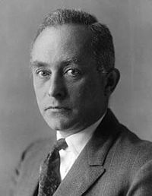
I believe that ideas such as absolute certitude, absolute exactness, final truth etc. are figments of the imagination which should not be admissible in any field of science….
The work for which I have had the honour to be awarded the Nobel prize in Physics for 1954, contains no discovery of a fresh natural phenomenon, but rather the basis for a new mode of thought in regard to natural phenomena”
(Max Born Nobel Laureate in Physics,
1954 In Seabrook, 2009, pp. 44-45)

Slide 18
Using biographical accounts of mobile academic intellectuals, my research has focused on
how mobility led to a new mode of knowledge creation in the process of becoming strangers and being positioned as academic migrants.

Slide 19
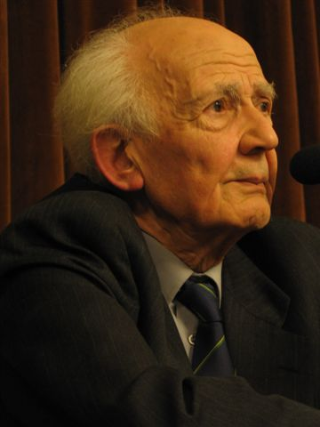
(Zygmunt Bauman, b1925) “Britain was the country of my
choice and by which I was chosen
through an offer of a teaching job
once I could no longer stay in
Poland, the country of my birth,
because my right to teach was
taken away.
But there, in Britain, I was an
immigrant, a newcomer – not
so long ago a refugee from
a foreign country, an alien.
I have since become a naturalized British citizen, but once
a newcomer can you ever stop being a newcomer?”
(Bauman 2004: 9)

Slide 20
Biographic Account: Norbert Elias (1897-1990)
Über den Prozess der Zivilisation (1939)
The Established and the Outsiders (1965)
The Civilizing Process: the history of manners. Vol. 1 (1969)
The Civilizing Process: Power and Civility; State Formation and Civilization Vol. 2 (1982);
Civilization and Violence (1982)

Slide 21
Norbert Elias (1897-1990)
He is now regarded as ‘one of the world’s most original and penetrating sociological minds’.
The convergence of Elias’s personal biography and his sociological theory in his propositions about established-outsiders relationships.
Elias’s biography suggests that critical incidents in his lifetime and the experiences of crossing boundaries – epistemic, academic culture, and territorial boundaries have intimately interwoven and led to new knowledge creation.

Slide 22
Having learnt to be ‘the Other’ means that I can never be Kiwi, nor do I aspire to be; after some years, however, I and other academic migrants like me may even become incapable of re-immersing ourselves in the academic world from which we came. We become the Other in both worlds and as a result will always be reflexive about our place in academic environments.
(Bönisch-Brednich, German Professor of
Anthropology in NZ, 2011).

Slide 23
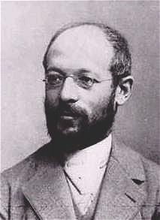
Georg Simmel (1858-1918) in his
essay ‘The Stranger’ in Soziologie
(1908) argued:
“To be a stranger is naturally a very positive relation; it is a specific form of interaction… He [the stranger] is not radically committed to the unique ingredients and peculiar tendencies of the group, and therefore approaches them with the specific attitude of “objectivity.” But objectivity does not simply involve passivity and detachment; it is a particular structure composed of distance and nearness, indifference and involvement.”
(Wolff, trans. Ed. 1950, 402-408).

Slide 24
Becoming a transnational academic is like assuming the position of a stranger - as conceptualised by
Georg Simmel (1908):
“the man who comes today and stays tomorrow, the potential wanderer has not quite gotten over the freedom of coming and going. He is fixed within a certain spatial circle – or within a group whose boundaries are analogous to spatial boundaries – but his position within it is fundamentally affected by the fact that he does not belong in it initially and that he brings qualities into it that are not, and cannot be, indigenous to it.”
(Simmel: Levine, D. trans. Ed. 1971: 143)

Slide 25
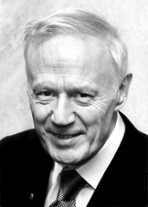
“I definitely think that not just in science,
but in any creative field of endeavour, it is
an advantage to have been a ‘minority’…,
be it through religion, ethnicity, or even
left-handedness.”….
“How far the experience of maintaining and defending - sometimes in public and in the face of some ridicule - beliefs and attitudes not shared by the vast majority of my compatriots may have influenced my subsequent attitude to physics and indeed to life in general.”
(Anthony Leggett (b1938), US-based British physicist & Nobel Prize winner in 2003, Times Higher Education 8 May 2008)

Slide 26
The concept of boundaries is partly drawn from work on collective identities - as explored by Barth (1969) and Jenkins (1996).
“Boundaries are permeable, persisting despite the flow of personnel across them, and identity is constructed in transactions which occur at and across the boundary.”
(Jenkins, 1996, p. 24)

Slide 27
Transnational Academic Mobility Making Boundaries (i)
--- >> Transnational Academic Mobility --- >>
Hard Soft
____________________________
Explicit Implicit

Slide 28
Transnational Academic Mobility Making Boundaries (ii)
Visible Invisible
_____________________________
Legal-rational Cultural- Reflexive
State Personal
Authority Adaptation

Slide 29
The patterns of academic mobility overlap with, and are constructed by, the characteristics of contemporary neoliberal market-framed universities:
new division of academic labour – research vs. teaching
vs. management
2. severe competition for external research funding and international recruitment of research staff and students
3. casualisation of academic labour in short-term, fixed-term contract-based staffing
4. implementation of immigration policies favourable to highly skilled foreign knowledge workers
5. changing styles of university leadership in corporatist governance and management
→ Conversion required from academic leadership (primus inter pares) to Managerial skills & competencies (line management)

Slide 30
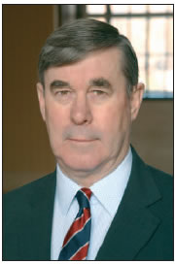
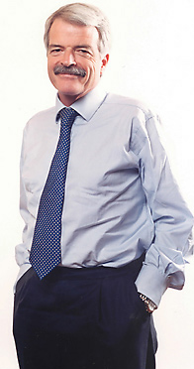
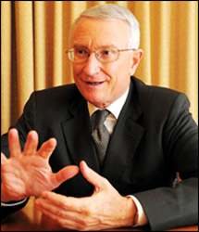
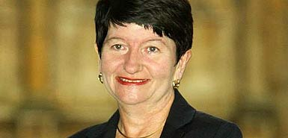
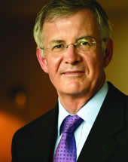
University of
St Andrews

Slide 31
Academic migrants in the contemporary neoliberal market-framed university
Such pressures to become a ‘self-managing academic’ who adheres to business thinking… are difficult enough for locals who have been slowly coerced into the corporatist performativity regime….
As an academic migrant, this often creates another layer of culture shock, experienced as a deep intrusion into my academic identity. Moreover, it is an imposition of another learning process: a third birth, a re-making of the academic self into a participant in an entrepreneurial system of producing and selling knowledge. Resisting this often means a slow or sudden professional death…
(Bönisch-Brednich, German Professor of Anthropology in NZ, 2011).

Slide 32
When do you feel foreign (i.e. as a non-UK national/European) in your academic and non-academic communities in the UK? “The only situation when I could possible get a feel of foreignness is when I am in a management meeting, surrounded by people who take things all too seriously, without a sense of distance, sober reflection, or critical examination of the system and its dogmas. But this lack of critical distance could be found amongst people from different cultures, it is not a national trait; it is a specific mentality that seems to be proliferating in the new academic culture.”
(Excerpted from the interview with Professor Galin Tihanov -George Steiner Chair of Comparative Literature, Queen Mary, University of London, Dec. 2011)

Slide 33
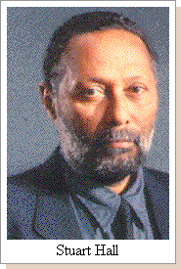
“Having been prepared by the colonial education, I knew England from the inside. But I’m not and never will be ‘English’. I know both places intimately, but I am not wholly of either place. And that’s exactly the diasporic experience, far away enough to experience the sense of exile and loss, close enough to understand the enigma of an always-postponed ‘arrival’.”
(Hall,1996: 492)
Stuart Hall - godfather of multiculturalism
and one of the UK's leading cultural
theorists

Slide 34
Transnational Academic Mobility Breaking Boundaries (iii)
Policy Implementation
______________________________
Official Internationalisation
Cultural Non-inclusion
Assuming the position of an Inside outsider /
Outsider within

Slide 35
Q: How significant are your nationality/ culture and identity to your academic work and new knowledge creation?
“Very significant in that as an expat, I do not feel a strong attachment to either one country or another. This allows a certain amount of academic and cultural freedom to create and explore third cultures--which carries with it the price of an inherent instability and lack of academic or social support.
This increasing number of foreign academics is an inevitable result of the demand not only for courses taught in English or other languages, but also for alternative perspectives and expertise. Perhaps in some cases, these foreign academics are contributing to the overall internationalization of Korean universities and creating new knowledge, but definitely not in my school, where quite the opposite is occurring--foreign professors are to be "kept in their place." A general ethos that permeates the work culture in my school is that foreigners are not the experts. We are merely hired hands to do the work that locals are unable to do.”
(Korean-American, male Professor of English Language Education working at one of major universities in Seoul, Korea for more than 10 years, Interviewed in December 2011/January 2012)

Slide 36
“…[my work] demonstrates how reliant I am on an essentially Anglo-Australian-American literature… I would not pretend to be as ‘international’ as some people like to lay claim to. In fact I think that sometimes being ‘international’ and having a ‘global’ perspective is over-emphasised, used as a bit of an empty boast and tends to devalue local knowledge and cognitive perspectives that cut across language/culture/nationality. That’s my thought anyway….. I guess I will always see myself as English and acknowledge that my cultural heritage is key in my work.”
(Excerpted from the interview with an English male academic working in Hong Kong, July 2011)

Slide 37
“In the US I was doing a postdoc and most of us were internationals, and worked really hard for a predominantly US faculty. This could be for a variety of reasons: postdocs tend to move like me or maybe that the scarcity of jobs had little prospects to move up it seemed. This two-tiered system was less visible to me in the UK (or maybe I did not notice it at the time). I am new to the Netherlands so I can't tell. They seemed to be pretty open despite recent changes in the law to make it harder for foreigners to work in the Netherlands... Generally speaking I constantly feel aware of my mixed ethnic background and the culture that comes with it and how it impacts on the audience to know how I can be authoritative in front of a predominantly male, white and English speaking audience…”
(Excerpted from the interview with a French female academic (with mixed ethnic backgrounds) working in the UK, USA and the Netherlands, Feb. 2012 )

Slide 38
“It is clear to me that I will always be an outsider when it comes to researching some aspects of the system. My choice of area of research the first time that I did make a conscious choice was that of the EU and that was precisely because of this feeling of coming from outside. …
National identity is a bit more tricky because I cannot tell you where the boundaries of one ‘identity’ finish and the other begins (national, cultural, personal …). Early on in my career I found that many people responded to me as a Greek first rather than as an academic… For instance, I gave two research seminars to present my work from the PhD in 1999 and 2000. In both of them, I had people at the end coming to ask questions not of the PhD work but of things that, to me, were irrelevant. The comments I would get were ‘your English is so good’, ‘very brave of you to come to a foreign country to study’, etc.. I did find this quite offensive, but not surprising. I had experienced it as well - as a PhD student with one of my supervisors [in Oxford] who would always comment about my language skills and almost never about the content of my work.”
(Excerpted from the interview with a Greek female academic who worked in England, April 2012)

Slide 39
On epistemic “predicaments of particularity and universality”
“To be recognised ‘internationally’, I not only write in English but also formulate my findings in terms of relevant theoretical debates in the English speaking academic centres. As a Japanese national writing about Japanese education in English, I am otherised by the English-language scholarship with my argument defined as localised and nationally specific. The ironic benefit of being otherised, however, is that I gain authority as the ‘native’ whose voice often enjoys more legitimacy than non-Japanese scholars of Japanese education because of my national and racial ‘authenticity’, though my authority is strictly confined within the specialised field of Japanese education.”
(Keita Takayama, Japanese academic in Australia; Excerpted from Takayama (2011) In Comparative Education, 47(4), 451)
Notes:
Keita Takayama, Japanese Comparative Educationist working in Australia expresses his terms with epistemic coloniality.
“To be recognised ‘internationally’, I not only write in English but also formulate my findings in terms of relevant theoretical debates in the English speaking academic centres. As a Japanese national writing about Japanese education in English, I am otherised by the English-language scholarship with my argument defined as localised and nationally specific.
However, I think Takayama does not move beyond this predicament to celebrate the structural connection between marginality and creativity that can overcome epistemic coloniality.

Slide 40
Conclusion
The condition of transnational mobility and the position of mobile academics have been structured by political and economic forces determining the boundaries and direction of flows, and also involve personal choices and professional networks (Kim 2008: 322-333).
The transnational flows of academic mobility and migration are more often shaped by the intellectual centre/periphery relationships rather than merely directed by pure economic incentives.

Slide 41
Significance of Marginality in Knowledge Creation
The position of a stranger enables mobile academics to explore the possibilities of a professionalization of strangerhood in knowledge creation.
4. However, it is not yet clear to what extent the new forms and types of transnational academic mobility in the contemporary neoliberal period have impacted on the recognition and promotion of diverse academic cultures, leading to new knowledge creation and innovation.
5. Meanwhile, the global expansion of neoliberal market-framed university regimes may leave very little space for free floating mobile academic intellectuals, whose positions as an inside outsider, or outsider within, whose work produces new comparative insights and creative knowledge.

Slide 42
Further reflection in my Conclusion
There are unequal power relations in forming and shaping new knowledge and identity capital – which are made visible in the life history of mobile academics and also in the structure of knowledge (re)production in higher education.
Geometries of global-local power and knowledge, through which interculturality is enmeshed with de-coloniality and re-coloniality simultaneously.

Slide 43
Mobile academics and universities can no longer afford to ignore this. Whilst more and more academics are mobile, and becoming transnational, perhaps not many of them are aware of the considerable power and values of transnational identity capital, or even its own existence.
In the new cartography of shifting global power relations, the type of transnational knowledge and identity capital possessed and carried by academic intellectuals is a powerful force to be directed with careful consideration of the longue durée impact and consequences of academic mobility in the future of globalisation - beyond the boundaries of nation-states.

Slide 44
For further discussion and future contact:
t.c.kim@uel.ac.uk

