Slide 1
Chinese Acupuncture Combined with Antidepressant Medication for Hospitalized Depression Patients
----A Pragmatic Randomized Controlled Trial
Dr. Tianjun Wang
School of Health, Sport and Bioscience

Slide 2
The Problems in Treatment of Depression
High incidence of disease: WHO
High relapse rate
High suicide rate
Lower visiting

Slide 3
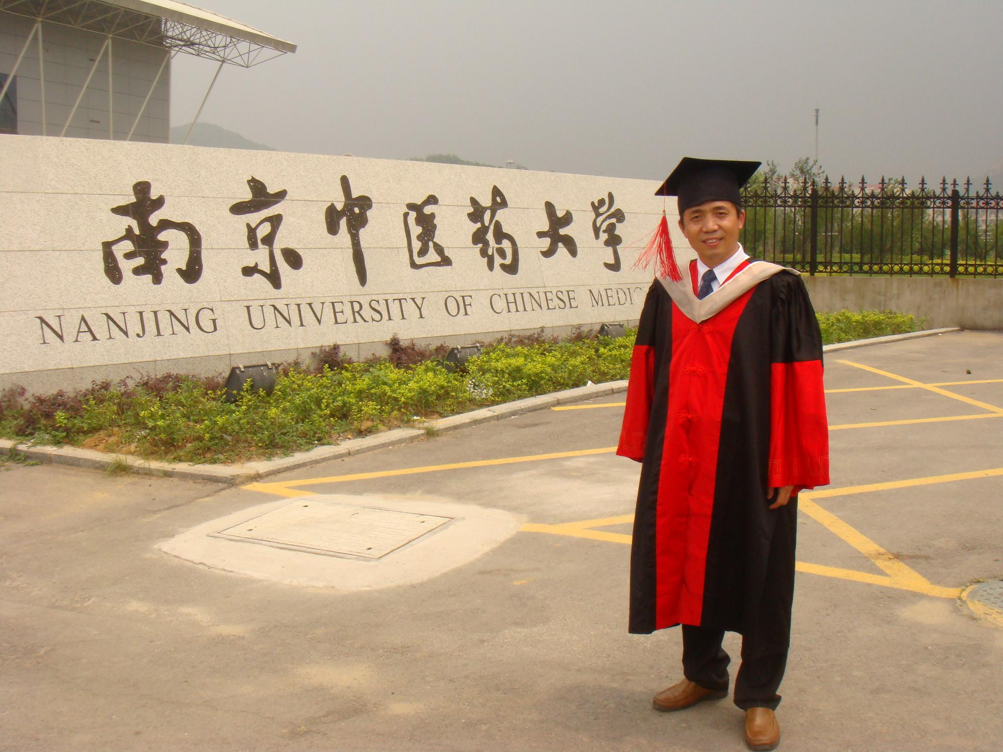
My PhD research— Clinic study
Literature review
Clinical study
Animal experiment

Slide 4
Patients screened 86
Violations of inclusion criteria Patient 9
Randomized patients 77
Intention to treat Patients with at least one treatment 76
Acupuncture Group 47
Control Group 29
Lost patients 2
Lost patients 3
Assessed after treatment 45
Assessed after treatment 26

Slide 5
Clinical Characteristics of Trial Groups
Table 1. Baseline Demographic and Clinical Characteristics of Trial Groups
 | Sex (F/M) |  | Age |  |  | Incidence
 | F (%) | M (%) | 50+ (%) | 31-50 (%) | 30-(%) | Single (%) | Recurrent (%)
TG (n=45) | 34 (75.6) | 11 (24.4) | 22(48.9) | 18(40.0) | 5(11.1) | 21(46.7) | 24(53.3)
CG (n=26) | 18(69.2) | 8(30.8) | 12(46.1) | 10(38.5) | 4(15.4) | 12(46.2) | 14(53.8)

Slide 6
Inclusive Criteria
CCMD III (Chinese Classification of Mental Disorders)
Hamilton Depression Rating Scale (HDRS) First 17 sessions total scales:17 or over
Age: 22-73

Slide 7
Exclusion criteria
Serious physical disease, brain organic diseases, alcohol and drug dependence and allergic conditions
In one month, any hormone drugs, nerve blockers, immune modulators, et al.

Slide 8
Assessment measures: HDRS
Hamilton Depression Rating Scale (HDRS)
Baseline assessment measures: Week0
Repeated post-intervention at one week after W0, two weeks W2, four weeks W4 and six weeks W6 thereafter.

Slide 9
Intervention
All the patients were prescribed one of the SSRIs (selective serotonin reuptake inhibitors) and health care.
TG (Acupuncture Treatment Group) patients were combined with acupuncture intervention by one senior acupuncturist.
CG (Control Group): SSRI only

Slide 10
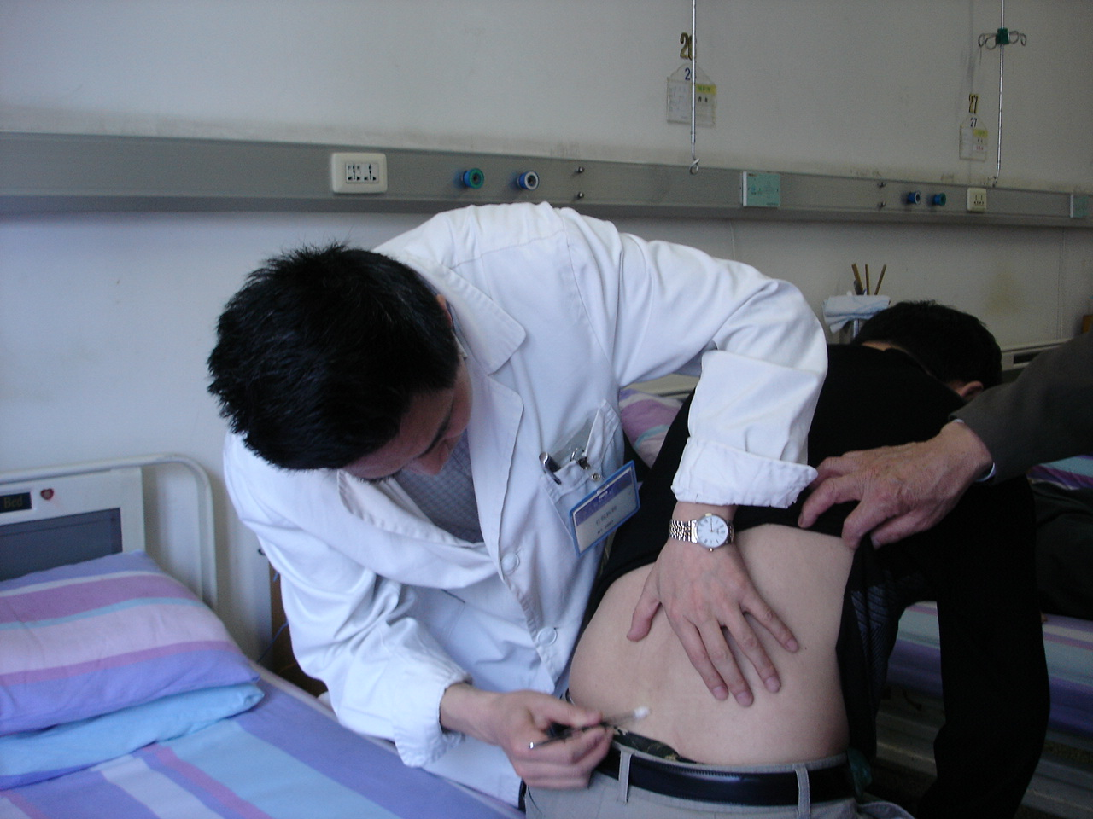
Acupuncture Treatment

Slide 11
Results

Slide 12
Results

Slide 14
Discussion
This pragmatic RCT efficacy trial compared the CG with conventional antidepressants and the treatment group with antidepressants combined with acupuncture; there was no non-treatment group.
This kind of pragmatic trial could benefit public health service guidance (Foster, 2007).
Foster, E.N, E. Thomas, P. Barlas, J. Hill, J. Young, E. Mason and E. M. Hay. Acupuncture as an adjunct to exercise based physiotherapy for osteoarthritis of the knee: randomized controlled trial. British Medical Journal. 335(7617): 436-447, 2007.

Slide 15
Discussion
The placebo or sham acupuncture control study may help to identify the effects of different acupuncture interventions but not the effectiveness of acupuncture as a whole therapy (Molassiotis et al, 2012).
Molassiotis, A., J. Bardy, J.J. Fennegan, P. Mackereth, D.W. Ryder, J. Filshie, J. Ream, E and Richardson A. Acupuncture for Cancer-Related Fatigue in Patients With Breast Cancer: A Pragmatic Randomized Controlled Trial. Journal of Clinical Oncology (online). doi: 10.1200/JCO.2012.46.0436. 2012.

Slide 16
Discussion
The design of acupuncture combined with medication versus medication only could not be blind (Smith et al, 2010).
Smith, C.A, P.P.J. Hay and H. Macphersonl. Acupuncture for depression (Review). The Cochrane Library 2010. Issue 1 http://www.thecochranelibrary.com/userfiles/ccoch/file/Acupuncture_ancient_ traditions/CD004046.pdf (Accessed 06/11/2012)

Slide 17
Discussion
Acupuncture combined with antidepressants appeared to speed the clinical effect, particularly the emotion, sleeping, body anxiety and total scales, even from the first week of treatment.
Arguably, the positive effects will continue beyond the six weeks trial.

Slide 18
Discussion
The limitations of this study are the small sample size of population and the lack of long term follow-up investigation.
In addition, further research could be designed with fewer doses of antidepressant medicine, plus acupuncture versus normal dose of antidepressants only.

Slide 19
Conclusion
Acupuncture combined with SSRIs can quickly improve the condition of depression and most of the other complaints surpass the intervention of SSRIs only. This improvement in patients continued throughout the six weeks of management.
Intervention of acupuncture has positively contributed to the treatment of depression.
Further studies of large sample trials and less doses of medication is warranted.
No adverse events were reported.

Slide 20
Many THANKS
Dr. Tianjun Wang
Senior Lecturer
Director of Acupuncture Clinic
UNIVERSITY OF EAST LONDON, UK
t.wang@uel.ac.uk
O: 020-82234557

